Slide 1
Clinical Key
ClinicalKey—a trusted, comprehensive source of clinical answers !!!!
Notes:
Hello. Today I’d like to talk to you about ClinicalKey, a truly innovative new product in development from Elsevier. ClinicalKey provides comprehensive, trusted clinical answers quickly and will revolutionize the way physicians at your institution access clinical information, allowing them more time to care for patients and reducing the chance of clinical errors.

Slide 2
Agenda
ClinicalKey—a trusted, comprehensive source of clinical answers !!!!
Identifying clinical search needs
ClinicalKey—addressing your needs – helps find right answer
ClinicalKey and Smart Content
Introducing EMMeT – improoving your searches
Enabling Speed to Answer
Smart Content driving relevant, adaptable, dynamic, customizable content
Notes:
To begin I want to give you an overview of some of the topics we’ll be covering today. First I want to cover some of the work that was done at Elsevier to identify key pain points in the search experience given the current offerings. Then, I’ll introduce you to ClinicalKey, which was designed to specifically address the issues we’ve identified. We’ll dive into Smart Content, the engine that drives ClinicalKey, and I’ll talk about our proprietary taxonomy, EMMeT, about how Smart Content increases your speed to answer when searching, and about how Smart Content drives relevant, adaptable, dynamic, customizable content on ClinicalKey.
After that I’ll introduce you to the trusted, comprehensive library of information that ClinicalKey provides access to, and how we’ve built ClinicalKey to align with physician workflows. Then I’ll finish up by talking about how ClinicalKey enables easier information sharing than ever before and discuss Meaningful Use.

Slide 3
Three Critical Pain Points for Clinical Searches
Comprehensive: Physicians frequently check a second source to get the full answer, because not all conventional clinical search engines are comprehensive
Trusted: Physicians often double-check answers, because not all conventional clinical search engines are trusted
Fast: Physicians waste time looking for relevant clinical answers because not all conventional clinical search engines deliver speed to answer
Notes:
Before diving into a description of ClinicalKey, I want you to understand that Elsevier wanted to develop a clinical search engine that would specifically address the needs of physicians. So we carried out extensive market research consisting of a survey sent to more than 2000 physicians. These physicians responded and identified 3 critical pain points.
The first of these was the need for an engine that was comprehensive. Physicians frequently check a second source to get the full answer, because not all conventional clinical search engines are comprehensive.
Next, a source needed to be trusted. But physicians often double-check answers, because not all conventional clinical search engines are trusted.
And, finally a source needed to be fast. Again, physicians frequently waste time looking for relevant clinical answers because not all conventional clinical search engines deliver speed to answer.

Slide 4
Conventional Clinical Search Engines Satisfy Some Key Requirements But Not All 3
In order to provide the best patient care possible, physicians need a new source of clinical answers
All trademarks are property of their respective owners.
Notes:
Unfortunately, no current offering delivers on all 3 requirements.
This means that physicians are spending valuable time searching for information instead of providing care for your patients.
In order to provide the best patient care possible, physicians need a new source of clinical answers.
[Note: Content by specialty for all Elsevier products are listed in the appendix.]

Slide 5
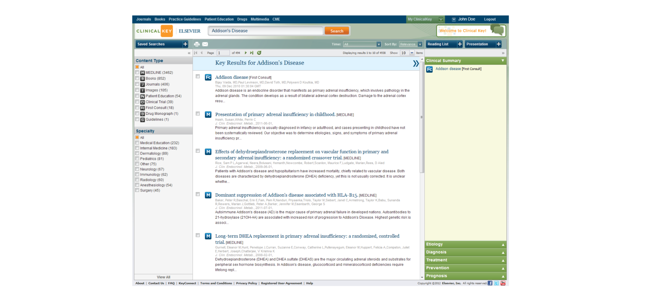
ClinicalKey Addresses Your Needs
ClinicalKey—Addison’s Disease Topic Page
Notes:
A simple search for “Addison’s disease” shows how ClinicalKey has been specifically and uniquely designed to satisfy these 3 key requirements:
1. With content from Elsevier, the world's leading provider of healthcare information, you know your results are trusted.
2. ClinicalKey draws answers from the largest collection of clinical resources, covering every medical and surgical specialty—eliminating physicians’ reliance on less accurate sources.
3. And finally, ClinicalKey has unique Smart Content that ensures physicians see the most relevant clinical answers all from one online source, reducing their search time and increasing the time they spend caring for patients.
On top of these benefits, ClinicalKey is designed to be incredibly intuitive. I’ll discuss later how it was specifically designed to structure information to align with physician workflows.

Slide 6
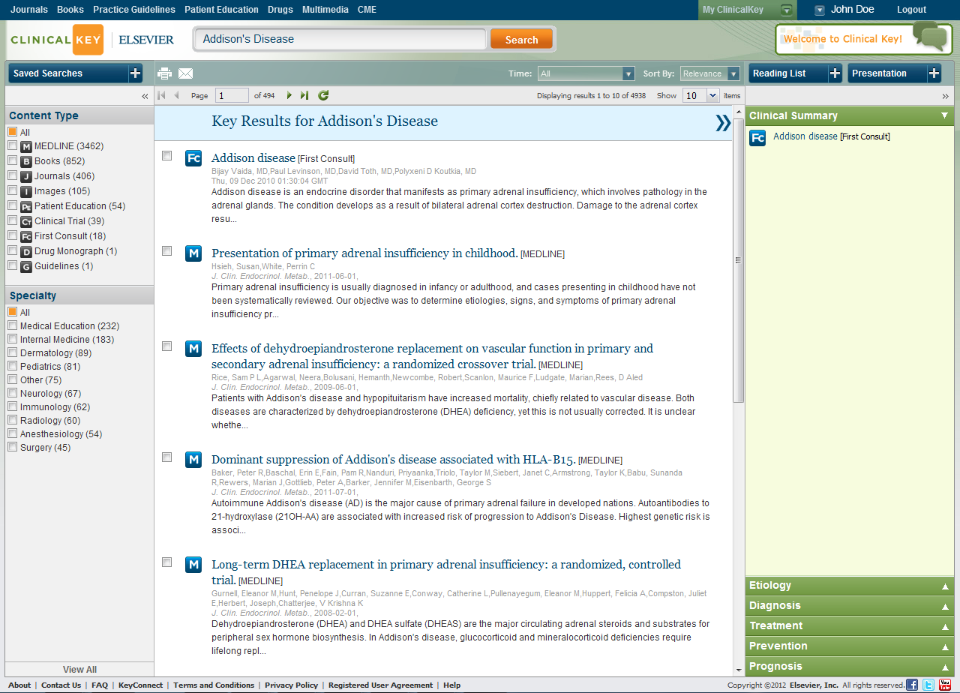
ClinicalKey Addresses Your Needs
Notes:
Now let’s take another moment to look at that results screen. Here you see the Search Term Topic Page for “Addison’s disease.” As you can see, it’s divided into 3 panels.
Left panel – This gives you the chance to refine your search results in a number of clinically meaningful ways—by information source (from journal article to drug monograph) or by any medical or surgical specialty
Center panel – This presents the search results. It’s showing you the most clinically relevant content relating to the search term “myocardial infarction.” The most clinically relevant article is shown right at the top. You can also choose to view your results by date of publication
Right panel – The exact content of the left panel will vary depending on the content type you have selected. In most cases, however, you will see a preview of the selected content. The preview panel allows you to see the most relevant paragraphs from a piece of selected content before you click through, so you can make sure it’s what you need before you waste time browsing the entire article

Slide 7
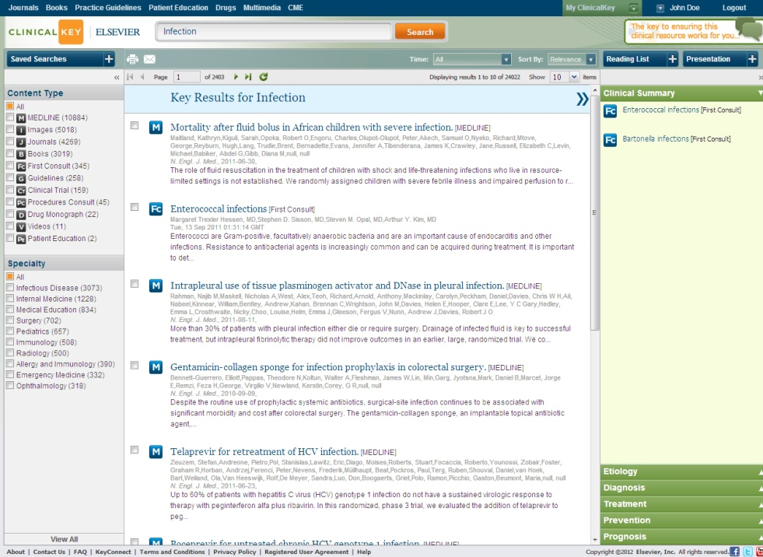
Personalize ClinicalKey for Greater Individual Workflow Alignment
Physicians can personalize ClinicalKey for greater workflow alignment, ensuring the most relevant results and cutting search time even further
Saved searches save physicians time!!!
Notes:
Physicians can also personalize ClinicalKey to create greater alignment with their individual workflows and reduce search time even further.
Personalization features allow ClinicalKey to consistently deliver the most relevant results:
Saved searches save physicians time
Personalized alerts keep physicians current when new information is available
The workflow alignment in ClinicalKey even extends to the design of its user interface, which has been specifically built so that the most relevant tools are immediately accessible.

Slide 8
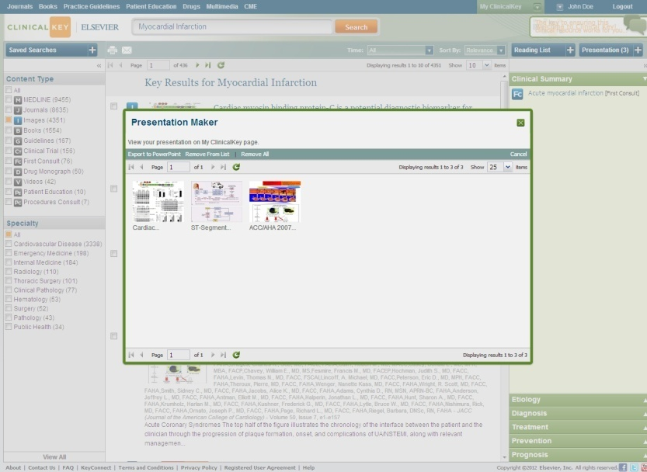
Information Found on ClinicalKey Is Easily Shared
Information found on ClinicalKey is easily shared, helping colleagues and care teams make the best decisions for patients
The Presentation Maker allows physicians to dynamically communicate the latest medical and surgical information to colleagues and care teams
Notes:
It was also critical to us that physicians be able to share information quickly. If physicians are able to ensure their colleagues have the latest, most relevant clinical answers, then they can ensure they are making the best decisions for their patients.
Information found on ClinicalKey is easily shared, helping colleagues and care teams make the best decisions for patients
The Presentation Maker allows physicians to dynamically communicate the latest medical and surgical information to colleagues and care teams
One click to share a paper, chapter, image, or video via email

Slide 9
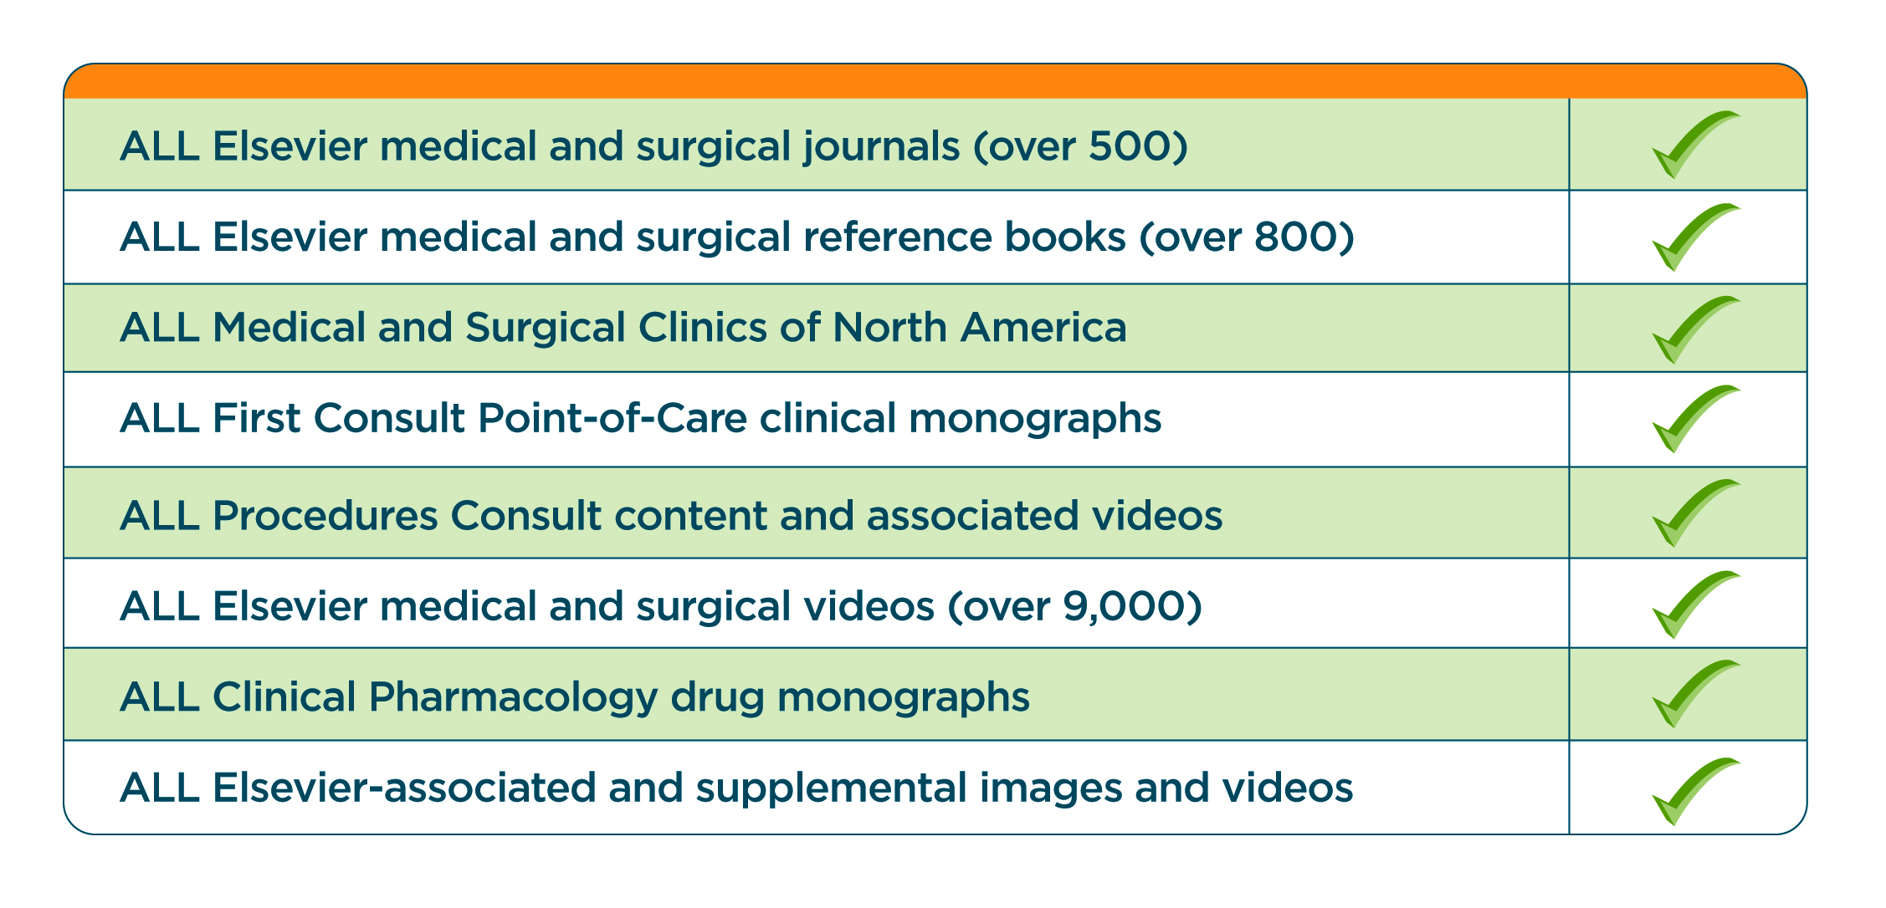
Draws Answers From the Largest Collection of Clinical Resources—Eliminating Physicians’ Reliance on Less Accurate Sources
Resources covering every medical and surgical specialty all from one online source
With ClinicalKey, be confident you are accessing the latest, most evidence-based answers
Plus:
Selected third-party journals and content sources
Guideline information
Elsevier and third-party published patient education materials
Fully indexed MEDLINE
Fully indexed clinical trials
Notes:
Now, not only does ClinicalKey deliver on speed to answer, but it’s also both comprehensive and trusted.
ClinicalKey draws answers from the largest collection of clinical resources—eliminating physicians’ reliance on less accurate sources. It has resources covering every medical and surgical specialty all from one online source and its content includes more than 800 books and 500 top journals in all medical and surgical specialties providing the most current evidence-based answers available, as well as expert commentary, MEDLINE abstracts, and selected third-party journals. And resources are not just limited to books and journals, but also include monographs, videos, and images. In fact, there are over 9,000 videos on ClinicalKey. This means information at all levels—from expert opinion to primary data—is available, providing your physicians with the resources to answer any clinical question all from one source, saving them time.
What's more, the content is provided by Elsevier, the world's leading provider of science and health information. They serve more than 30 million scientists, students, and health and information professionals worldwide and have fostered the peer review process for more than 130 years. Elsevier has an established history of increasing the productivity and effectiveness of healthcare professionals.
With ClinicalKey, your physicians can be confident they are accessing the latest, most evidence-based answers, answers they can trust to help reduce clinical errors.

Slide 10
A ClinicalKey Subscription Can Help Improve Patient Care at Hospitals of Every Size
A subscription offers access to:
Newest online clinical information resource The latest practice guidelines
Trusted, evidence-based medicine in both core medical and deep specialty areas
ClinicalKey subscriptions are customizable to meet your institution's specific needs
Notes:
A ClinicalKey subscription can help improve patient care at hospitals of every size.
[For CMOs/CMIOs of hospitals without a medical library]
ClinicalKey offers staff and prospective doctors an elite, online clinical-information resource with the breadth of access that rivals large academic institutions
Physicians have access to the same quality of in-depth specialty information that they would expect at a teaching institution with an extensive library
ClinicalKey offers a breadth of access that can supplement information supplied by colleagues
[For CMOs/CMIOs of mid-size hospitals]
Physicians can keep current with practice guidelines
ClinicalKey offers access to trusted, evidence-based medicine in general and specialty medical topics
ClinicalKey offers a breadth of access that can supplement information supplied by colleagues
[For CMOs/CMIOs of large metropolitan hospitals]
Physicans gain access to trusted, evidence-based medicine in both core medical and deep specialty areas, allowing you to continue your commitment to education
The breadth of access available through ClinicalKey allows you to support all your specialists with just one source
What's more, ClinicalKey subscriptions are customizable to meet your institution's specific needs, you can ensure cost-efficiency with fully COUNTER-compliant usage reports.

Slide 11
ClinicalKey Ensures Clinically Focused Content Is Never Out of the Physician’s Reach
The latest clinical information accessible directly at the point of care through any device with a Web connection (iOS, Android, Windows Mobile, etc)
A clean, intuitive interface
Ensures you waste no time training physicians
Notes:
As you can see, a subscription to ClinicalKey ensures clinically focused content is never out of the physician’s reach. It provides physicians with leading clinical information fast so they can make the best decisions with less chance for error. The site is accessible from any device with a Web connection, including iPads and iPhones, as long as they’re within range of your institution’s IP address. What’s more, ClinicalKey presents doctors with a clean, intuitive interface. This interface has the added benefit of ensuring that you don’t have to waste time training your physicians to use ClinicalKey.

Slide 12
Unlike Other Conventional Search Engines, ClinicalKey Satisfies All 3 Clinical Search Requirements
Notes:
So, as we have discussed, ClinicalKey satisfies all 3 of the search requirements we discussed. It is:
Comprehensive, supplying answers from the largest collection of medical resources in every medical specialty
Trusted, providing access to answers from Elsevier’s authoritative medical and surgical content
Fast, with Smart Content enabling fast discovery of the most relevant answers and allowing more intuitive searching
By satisfying all 3 key search requirements, ClinicalKey can be a unique asset to your institution, with the potential to impact patient outcomes.

Slide 13
Frequently Asked Questions
Is training required to use ClinicalKey?
No, physicians don’t have to waste time training due to the clean, intuitive interface. However, usage tips and tools are available if you want to discuss them
How does ClinicalKey ensure comprehensive results?
To ensure it provides comprehensive results
ClinicalKey answers from the :
largest collection of published medical resources in every medical and surgical specialty,
all MEDLINE abstracts with access and entitlements to other full-text purchases when used with an institution’s link resolver.
Notes:
Do you have any further questions I can answer?
Is training required to use ClinicalKey?
No, physicians don’t have to waste time training due to the clean, intuitive interface. However, usage tips and tools are available if you want to discuss them.
How does ClinicalKey ensure comprehensive results?
To ensure it provides comprehensive results, ClinicalKey supplies answers from the largest collection of published medical resources in every medical and surgical specialty, and includes all MEDLINE abstracts with access and entitlements to other full-text purchases when used with an institution’s link resolver.

Slide 14
Frequently Asked Questions
Exactly what content can be accessed through ClinicalKey?
Content on ClinicalKey includes:
All the Elsevier medical and surgical journals with issues going back for the past 4 years. That’s over 500 journals now, and the number is growing
All Elsevier medical and surgical reference books. Currently, that’s over 800 books
All Medical and Surgical Clinics of North America
All First Consult Point-of-Care clinical monographs
All Procedures Consult content and associated videos
All Elsevier medical and surgical videos (over 9,000)
All Clinical Pharmacology drug monographs
All Elsevier-associated and supplemental images and videos
Selected third-party journals and content sources
Guideline information
Elsevier and third-party published patient education materials
Fully indexed MEDLINE
Fully indexed clinical trials
Notes:
Exactly what content can be accessed through ClinicalKey?
Content on ClinicalKey includes:
All the Elsevier medical and surgical journals with issues going back for the past 4 years. That’s over 500 journals now, and the number is growing
All Elsevier medical and surgical reference books. Currently, that’s over 800 books
All Medical and Surgical Clinics of North America
All First Consult Point-of-Care clinical monographs
All Procedures Consult content and associated videos
All Elsevier medical and surgical videos. That’s over 9,000
All Clinical Pharmacology drug monographs
All Elsevier-associated and supplemental images and videos
Selected third-party journals and content sources
Guideline information
Elsevier and third-party published patient education materials
Fully indexed MEDLINE
Fully indexed clinical trials

