Slide 1
An Author’s Guide to Scientific Publishing
Do’s and Don’ts when Writing a Scientific Article
Karger Publishers, Basel, Switzerland
www.karger.com

Slide 2
Table of Content
Do's and Don'ts
Further Information
Contact Details
Notes:
First I would like to give you a very short introduction – who Karger Publishers is and how our connection to China is reflected in our program.
In the practical parts
Publishing
Before writing
Do’s and Don’ts
We concentrate on important topics you should be aware of when you prepare a manuscript and submit an article to a publisher
The scientific excellence is your own responsibility, but to be accepted for publishing there are also a lot of formal points you must consider. All to often papers are rejected out of formal reasons.
But lets start now with the short introduction

Slide 3
1. Do’s and Don’ts
Guidelines for Authors
Please refer to the notes in the author guidelines how to prepare a manuscript (sometimes also called «Instructions to Authors», «Manuscript Guidelines», or «Manuscript Style Guide»). → Read them carefully.
Guidelines varies from publisher to publisher – even from journal to journal.
Observe the instructions rendered in the guidelines: e.g. about the «Arrangement», that is the structure of the article, or e.g. the required statements such as «Conflicts of Interest».

Slide 4
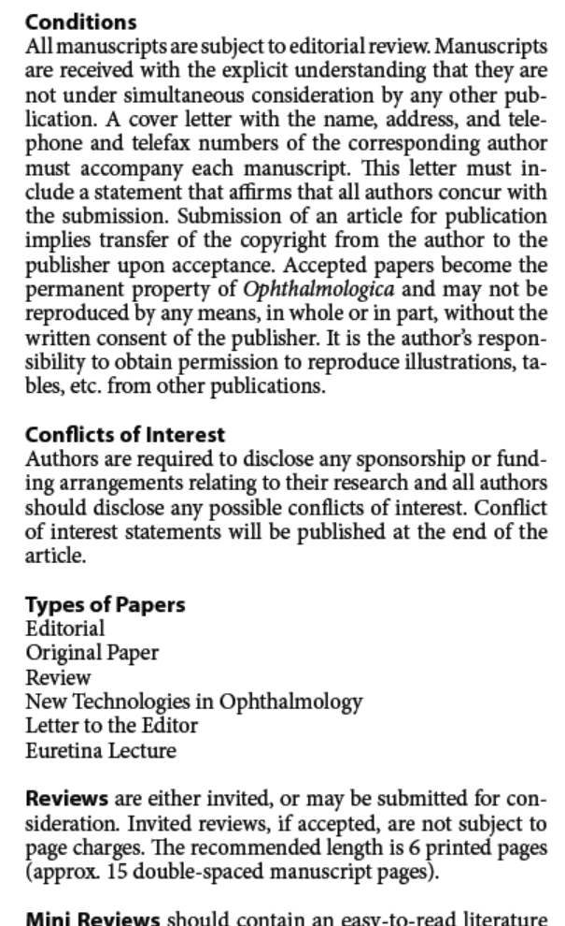
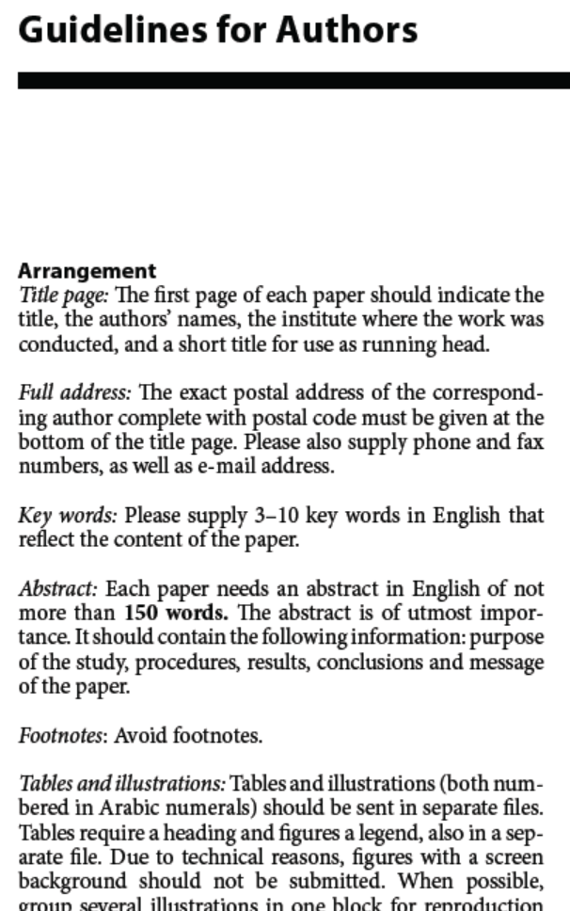
www.karger.com/Journal/Guidelines/224164
www.karger.com/Journal/Guidelines/224269
www.karger.com/Journal/Guidelines/223829
www.karger.com/Journal/Guidelines/223854

Slide 5
1. Do’s and Don’ts
Language
Use simple sentences
Take care to express your ideas clearly
Use simple standard English
Follow the rules of grammar / tenses
Use subject-specific conventions (numbers, international units of measurement, terminology)
Ask an native English-speaking colleague or look for professional help
For language editing services in Asia, we recommend the company ThinkSCIENCE Inc., www.thinkscience.co.jp
For other regions, see www.karger.com/Resources/Authors

Slide 6
1. Do’s and Don’ts
Article Structure
Structure of a Research Article/Original Paper
See Examples:
The Very Long-Term Outcome of Radiosurgery for Classical Trigeminal Neuralgia
Régis et al., Stereotact Funct Neurosurg 2016;94:24-32 (DOI:10.1159/000443529)
Modelling the Cost-Effectiveness of Delaying End-Stage Renal Disease
De Vries et al., Nephron 2016;133:89-97 (DOI:10.1159/000446548)

Slide 7
1. Do’s and Don’ts
Abstract
Within the word limit
Correct format
Structure your abstract in at least four sections:
What problem did you focus on?
How did you obtain your results?
What results did you obtain?
What are the implications of your findings?
Background too short/too long
Not give the expected information
Not stating the implications clearly
Too many abbreviations
Wrong format for the journal
Further example - see also next page

Slide 8
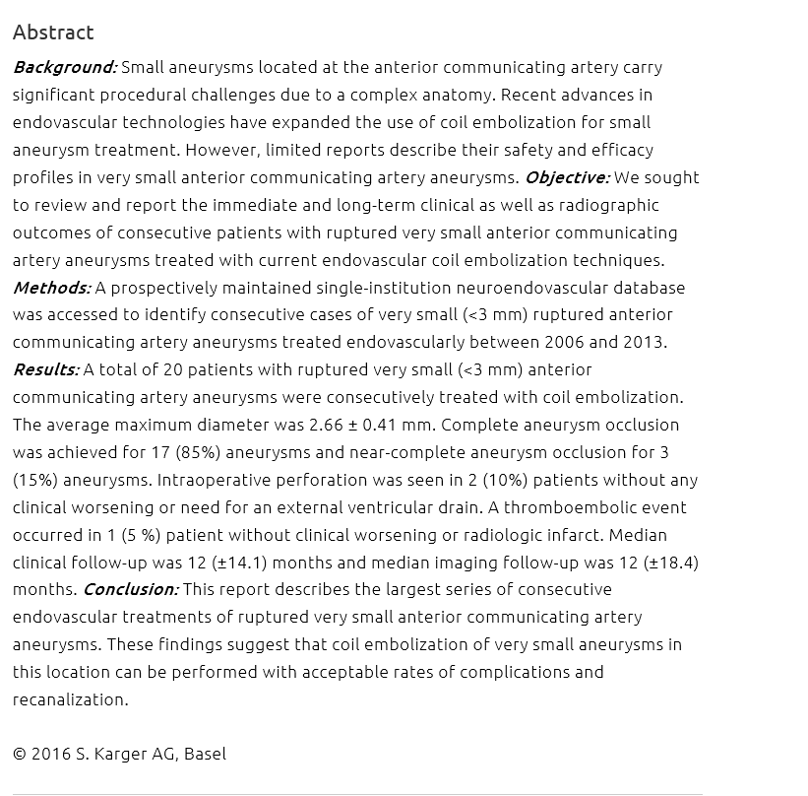
Asif et al.
Intervent Neurol 2016;5:57-64 DOI:10.1159/000444662

Slide 9
1. Do’s and Don’ts
Introduction
General background
Previous research
Problem your study addressed
Hypothesis (focus of your paper)
Aim
Too much/too little background
Not well organized
Aim (hypothesis) not clear
Example - see also next page:
Clinical Risk Factors and Plaque Characteristics Associated with New Development of Contralateral Stenosis in Patients Undergoing Carotid Endarterectomy

Slide 10
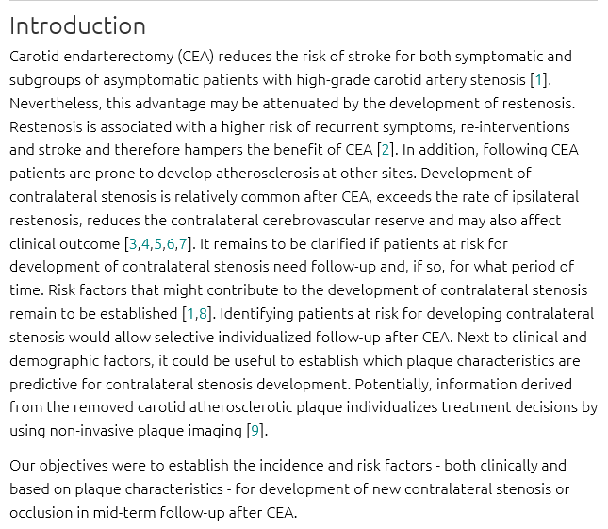
Merckelbach et al.
Cerebrovasc Dis 2016;42:122-130 DOI:10.1159/000445529

Slide 11
1. Do’s and Don’ts
Methods
Study design
Participants, parameters tested
Instruments, devices, and procedures
Ethic statements
Statistical analysis
Organize clearly
Use subheadings
Poorly organized (wrong order)
Too little detail (study cannot be replicated)
Too much detail
Describes experiments whose results are not shown
Mentions results
Too long
Material and manufacturer information wrong
Example - see also next page:
Type-Specific Identification of Genital Human Papillomavirus Infection in Women with Cytological Abnormality

Slide 12
Vargas et al.,
Acta Cytologica 2016;60:211–216
DOI: 10.1159/000446389

Slide 13
3. Do’s and Don’ts
Methods
Too little detail (study cannot be replicated)
Images were obtained using an MR scanner.
Images were obtained using a 3-Tesla MR scanner system (Philips, Best, the Netherlands) with a standard 8-channel SENSE head coil.
Notes:
Note: Examples on the next slides – let the audience think – where more details are necessary
You have to mention which scanner was used – to your fellow scientists – and also for the reviewers – this is a important information.

Slide 14
1. Do’s and Don’ts
Methods
Too little detail (what, when, where)
Study population
Subjects with Crohn’s disease were recruited in the outpatient clinic at the Hospital São Rafael, a tertiary referral center.
Study Population
Subjects with Crohn’s disease were recruited between January 2014 and December 2015 in the gastroenterology outpatient clinic at the Hospital São Rafael, a tertiary referral center in Salvador, Bahia, Brazil.

Slide 15
1. Do’s and Don’ts
Results
Main findings that support your ‘story’
BUT be balanced and honest
Well organized
Supported by tables, graphs, and figures
Clear and concise
Includes the implications of your results
Repeats the subheading in the running text
Results section too long/wordy
Example - see also next page:
Overexpression of AQP5 Was Detected in Axillary Sweat Glands of Primary Focal Hyperhidrosis Patients

Slide 16
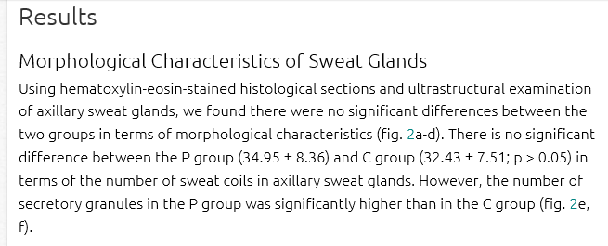
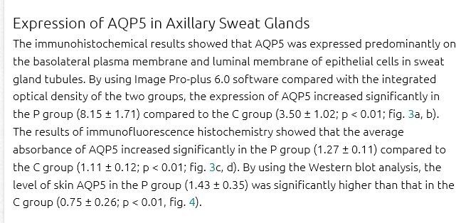
Du Q. et al.
Dermatology 2016;232:150-155 DOI:10.1159/000444081

Slide 17
1. Do’s and Don’ts
Results
Repeats the subheading in the running text
Results
Correlation of Biomarkers with Age
In terms of the correlation of biomarkers with age, In the DS group, the concentration of Aβ1–42 correlated negatively with age (r_{s}= –0.69, p = 0.015), while T-tau had a positive correlation with age (r_{s} = 0.68, p = 0.025; fig. 2a).

Slide 18
1. Do’s and Don’ts
Figures and Tables
High resolution
Simple and clear
Neatly formatted
Stand-alone legends/captions
Poor formatting
Too many colors
Inconsistent font, point size, capitalization
No scale markers on micrographs
Abbreviations not defined
Too many images
Duplication between text and figure/table
Example
Exploring Alzheimer Molecular Pathology in Down's Syndrome Cerebrospinal Fluid

Slide 19
1. Do’s and Don’ts
Discussion
Main Findings
Do the data support your hypothesis or a different one?
How do your findings compare with published findings?
Limitations of your study
Ideas for future research
Conclusion (short; take-home message only!)
Repeats your results without discussion
Poor organization/logical flow
Implications not stated/overstated
Conclusion too long
Example – see also next page:
Different Seasonal Patterns in Song System Volume in Willow Tits and Great Tits

Slide 20
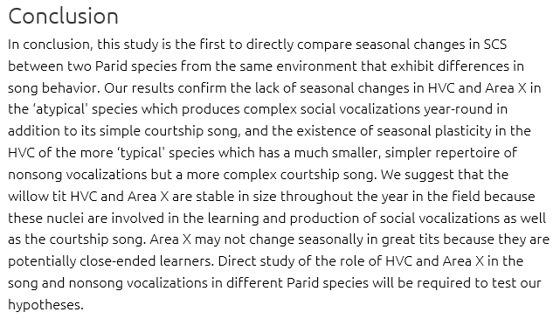
Longmoor et al.
Brain Behav Evol 2016;87:265-274 DOI:10.1159/000447114

Slide 21
1. Do’s and Don’ts
References
Two types:
In-text citations
Reference section
Use a referencing program
Format the Reference section for your target journal
Cite while you write!
Wrong formatting in the text
Wrong formatting in the Reference section

Slide 22
1. Do’s and Don’ts
Required Statements
Potgieser et al.,
Neurodegener Dis 2014;14:125–132
(DOI:10.1159/000363245)
www.icmje.org/conflicts-of-interest
Nehme et al.,
Caries Res 2016;50:62-70 (DOI:10.1159/000443187)
www.publicationethics.org
Quan Du et al.,
Dermatology 2016;232:150–155
(DOI: 10.1159/000444081)

Slide 23
1. Do’s and Don’ts
Final Remarks
Declare that the work is your own work
Give a statement on the involvement of all authors to make their contribution clear
Avoid multiple submissions
Say if your work has been published in part or in whole somewhere else so that there is no doubt about plagiarism or double publications
Avoid predatory publishers

Slide 24
2. Further Information

Slide 25
4. Further Information
Open Access
Terms relevant to publishing an article in an open access journal
Open Access: Online access of articles for free worldwide
Directory of Open Access Journals (DOAJ): An online directory that indexes and provides access to peer-reviewed journals
Green Open Access (Self-Archiving): Accepted manuscript for archiving in non commercial repository
Gold Open Access - Article Processing Charge (APC): A one-time publishing fee paid by authors (or their funders or institutes) on acceptance of their paper
Hybrid Open Access - Author’s Choice: Karger’s option to publish open access articles in subscription journals
Creative Commons licenses: Public copyright licenses that enable authors to share their work
www.karger.com/OpenAccess
Notes:
If your grant or funding sponsor or the policy of your university or institution requires open access publication then you have to choose accordingly.
Here are some important terms you need to know when publishing open access

Slide 26
2. Further Information
PubMed/Medline
If you are looking for the right journal to publish in or searching an article for a specific topic to cite
you can use the PubMed/Medline database for your search
you can create individual search routines using the PubMed Advanced Search Builder that can be saved by personalizing your PubMed account.
A video tutorial for using the PubMed Advanced Search Builder is available at You Tube
Other useful databases are e.g. Thomson Reuters Web of Science

Slide 27
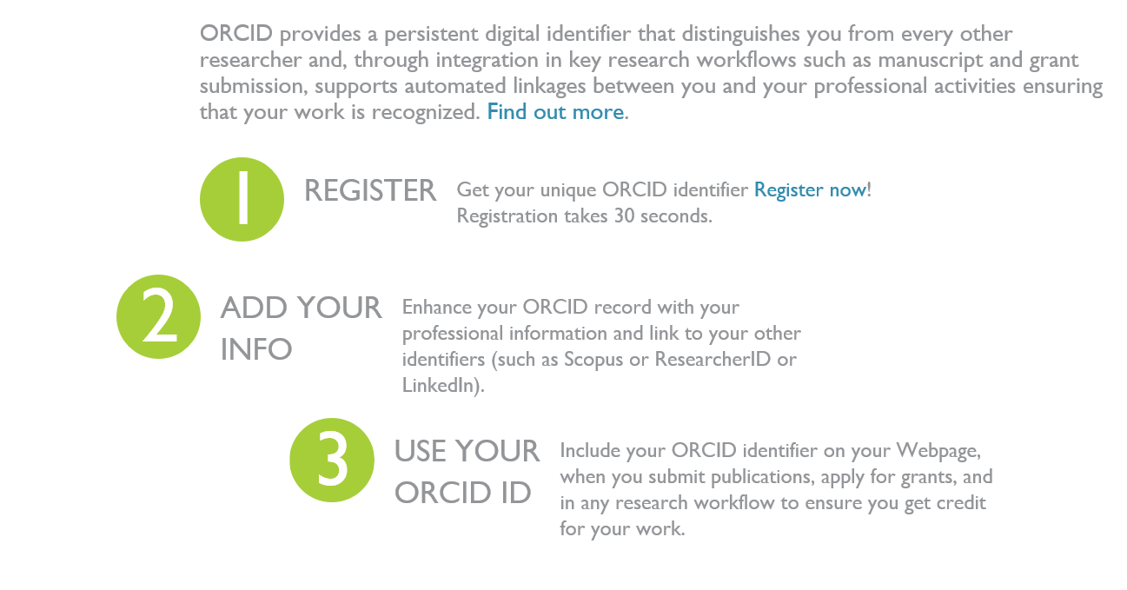
2. Further Information
ORCID
A service which provides a registry of unique researcher identifiers
www.orcid.org

Slide 28
3. Contact Details

Slide 29
3. Contact Details
If you have any further questions, do not hesitate to contact Karger Publishers!
Find us at: www.karger.com
E-Mail: service@karger.com
For language editing services in Asia, we recommend the company ThinkSCIENCE Inc., www.thinkscience.co.jp
For other regions, see www.karger.com/Resources/Authors
For publication projects in Asia, please contact Peter Roth,
Head of Editorial Division Asia (EDA), p.roth@karger.com

Slide 30
About Karger Publishers
Karger Publishers in Basel, Switzerland, is a globally active medical and scientific publishing company. Independent and family-run in the fourth generation, Karger is dedicated to serving the information needs of the scientific community with publications of high-quality content, covering all fields of medical science. The company puts great emphasis on direct and personal relationships with all its partners.
Connecting the World of Biomedical Science

