Slide 1
Attila Balogh MD
Founder
4D Anatomy
Interactive multidimensional display of anatomic dissections and simulated surgical procedures
INFORMATIO SCIENTIFICA – INFORMATIO MEDICATA
2012

Slide 2
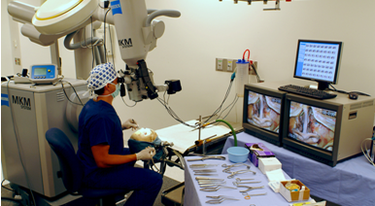
History
The Barrow Neurological Institute
Private and Confidential
Notes:
2

Slide 3
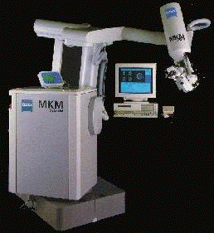
The Zeiss MKM system
Wight: 1000 kg
Large size
Slow (1layer/4 hours)
Expensive (1 millio USD)
Complicated controlling
6 DOF
No more manufactured

Slide 4
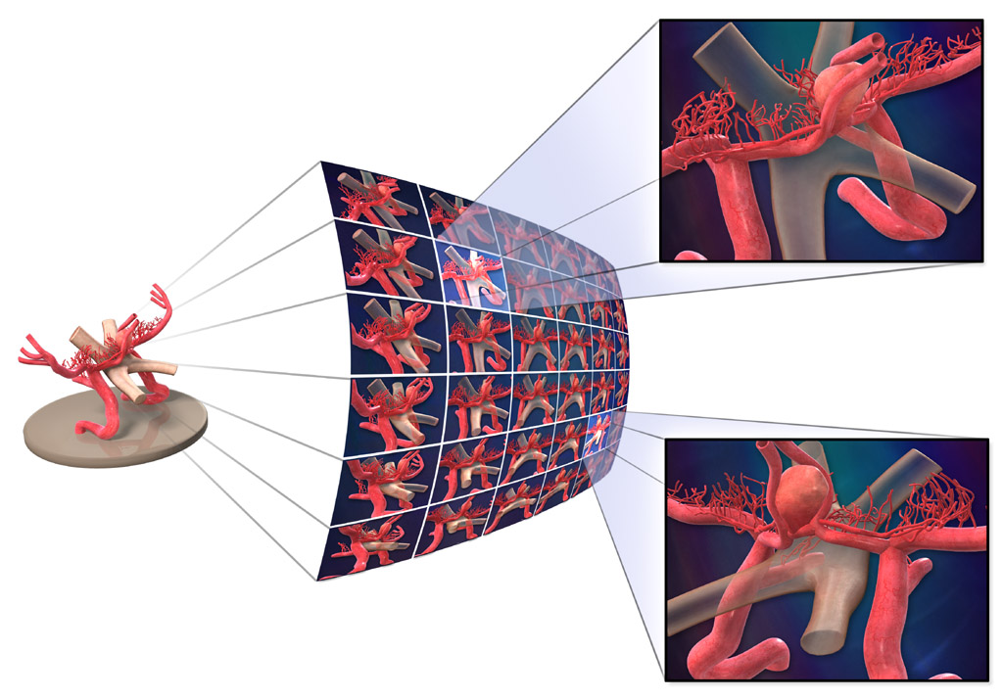
Image grid

Slide 5
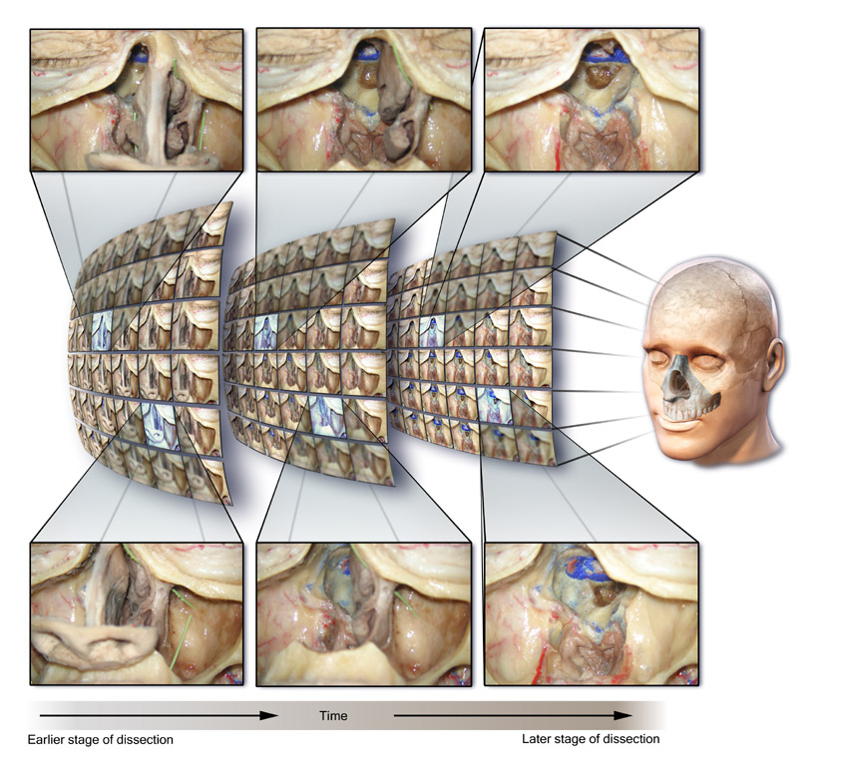
MIGRT for Anatomy

Slide 6
The 4D Anatomy
Project & Platform
Goals:
Scanning the entire human body using 4D technology
Create a multidimensional atlas of anatomy based on interactive photo reconstructions
Provide a state of the art education tool for anatomy which provides the closest to reality visual experience of anatomy dissections

Slide 7
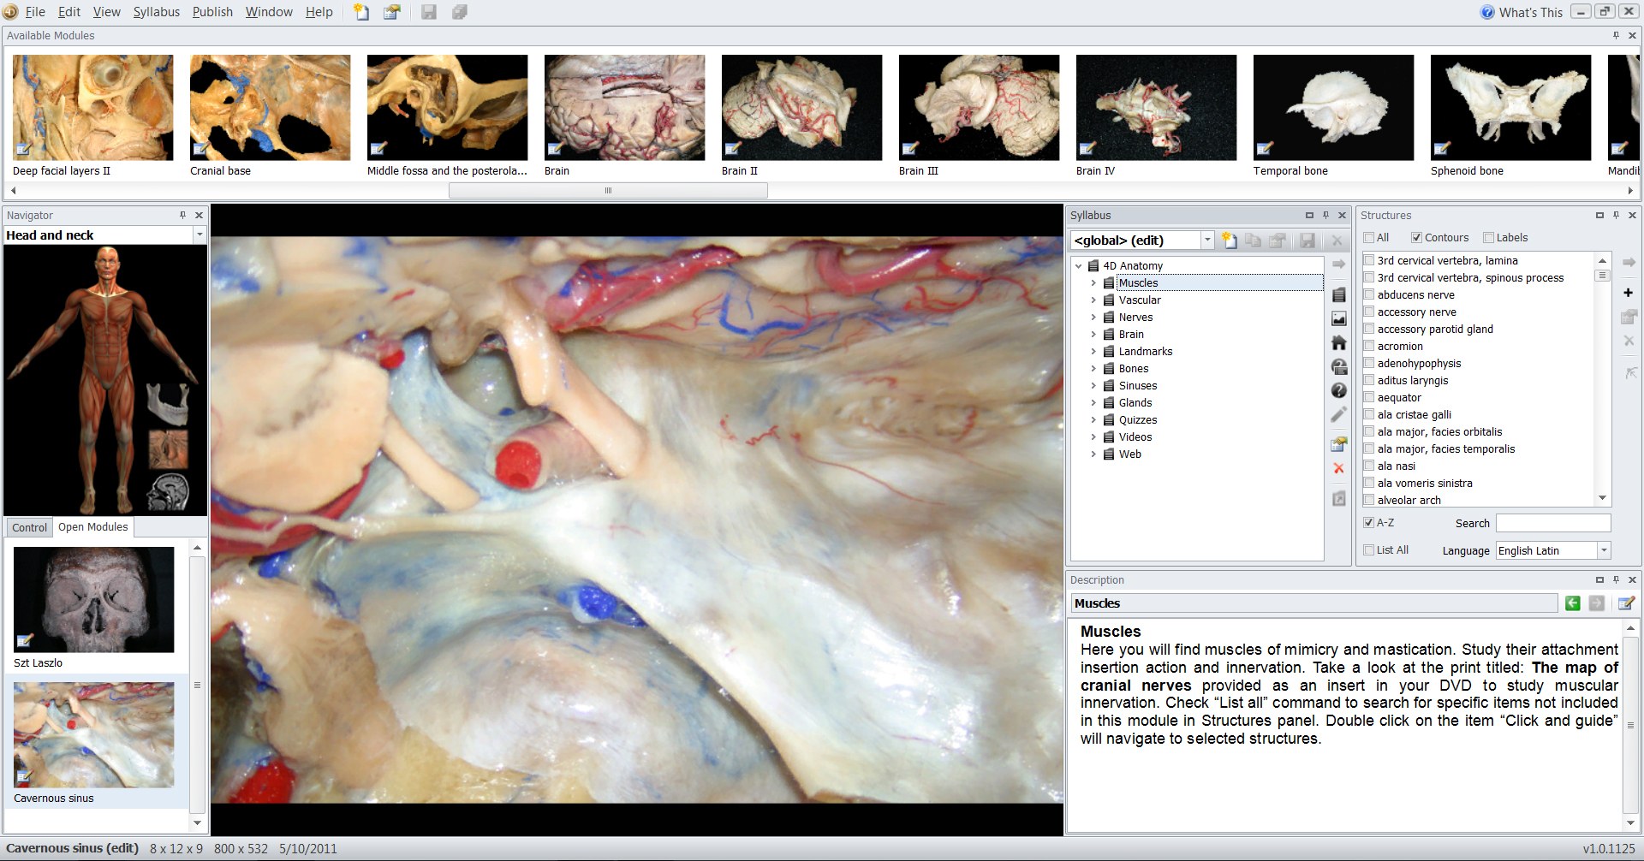
4D Anatomy content
Interactive modular content
eLearning syllabus

Slide 8
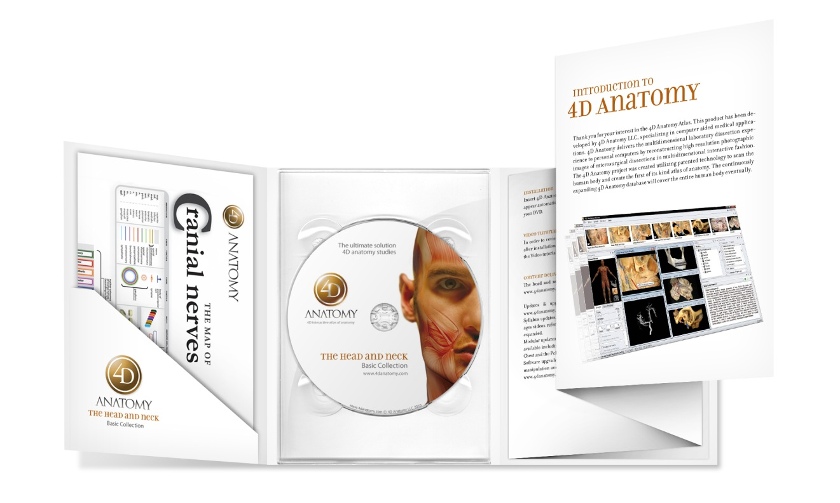
The head and neck Basic Collection
2010
DVD format

Slide 9

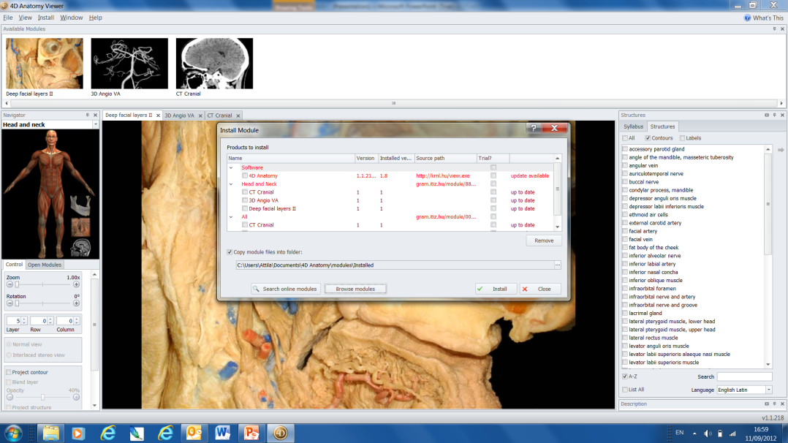
Streaming online version
DVD
Subscription

Slide 10
Streaming online advantages
No drive space required
Fast access
Monthly and annual subscription
Multi seat user license for institutions
Available Online and offline
4D Anatomy is a continuously expanding database

Slide 11
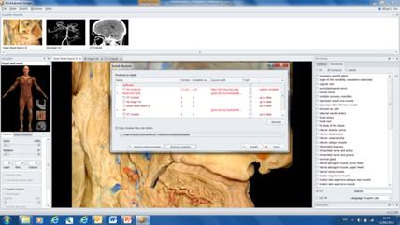
4D Anatomy Platform
Imaging lab 1
4D Anatomy Editor & NeuroArc scanner
Imaging lab 2
4D Anatomy Editor & NeuroArc scanner
Imaging lab 3
4D Anatomy Editor & NeuroArc scanner
License database
Media server
4D Anatomy Viewer

Slide 12
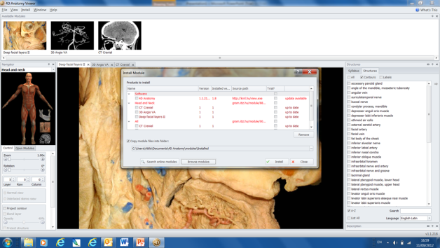
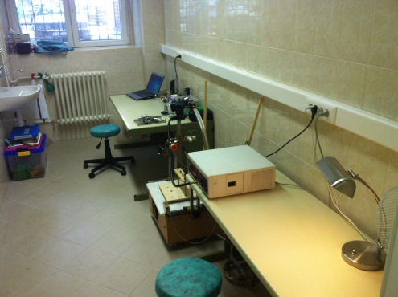
4D Anatomy imaging network
Semmelweis University
4D Anatomy database
Stanford University
BNI

Slide 13
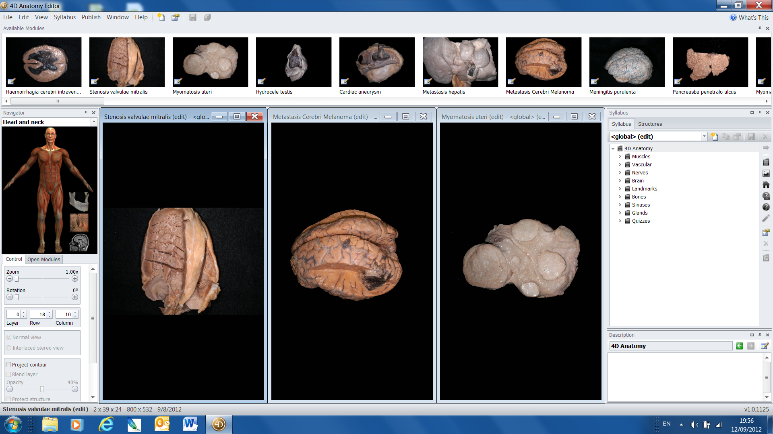
New apps: 4D Pathology
1 million grant won in partnership with Semmelweis University

Slide 14

Imaging lab at Semmelweis University
Cadaver
Instruments
scanner
2 anatomists
1 PhD Student
Articles

