Slide 1
Deep Indexing in ProQuest Health and Medical Databases

Slide 2
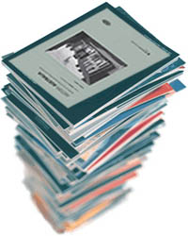
The Problem: There is Limited Time Available to Scan a Discipline
Scholarly output is seemingly growing exponentially year after year
Various useful tools have come available to aid clinicians by summarising available evidence, and by identifying relevant content to keep knowledge current on specific topics
But what if we look upstream, and consider the researchers for a moment…the same types of tools are in many ways, not relevant
Often the researcher’s goal "is not to find an article to read, but rather to find, assess, and exploit a range of information by scanning portions of many articles“.
-Strategic Reading, Ontologies, and the Future of Scientific Publishing -- Renear and Palmer 325 (5942): 828 – Science VO 2009 IS 12/8/2009NO id: 1 ED http://www.sciencemag.org/cgi/content/abstract/325/5942/828

Slide 3
Aiding the Researcher: Better Enabling Discoverability and Efficiency in Searching
Provide tools that:
Facilitate efficient, precise and relevant search retrieval
Lead the researcher to the right choice of full text, quickly
Notes:
What is Deep Indexing?

Slide 4
Aiding the Researcher: Better Enabling Discoverability and Efficiency in Searching
Tables and figures embedded within scholarly articles are often the distilled essence of the research – the closest thing to the raw datasets
Tables and figures can assist a user with the ability to quickly establish the relevance of an article to their research
Unfortunately, traditional indexing in bibliographic databases is done at the article level
Tables and graphs are very often invisible in traditional search environments

Slide 5
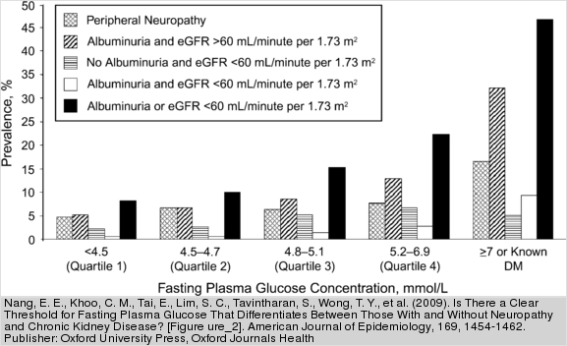
Aiding the Researcher: Better Enabling Discoverability and Efficiency in Searching
A full text search bypasses the image files
Text in tables & figures are considered a part of the image, not searchable text
Essential content from within tables and graphs often does not appear in a traditional index
E.g. MeSH terms for the article from which the graph below was extracted do not include “Albuminuria”, the unit of measurement
reflected in the graph; nor does the term appear in the article abstract
Notes:
…Rendering possibly the most relevant articles, invisible to the researcher
The unit of measurement in the graph

Slide 6
Aiding the Researcher: Deep Indexing of the Scholarly Literature
The Cambridge Scientific Abstracts part of the ProQuest business began a unique innovation in bibliographic databases in 2005 by deep indexing the literature of natural sciences and technology
Over the past few years have been dramatically increasing the coverage of biomedical journals

Slide 7
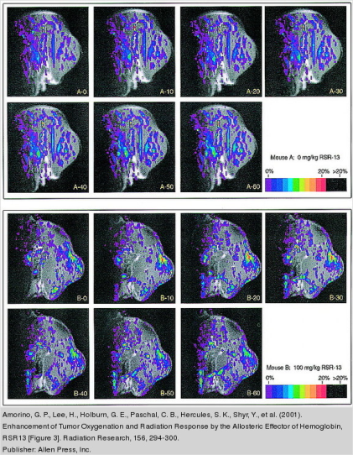
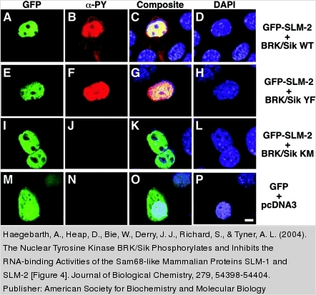
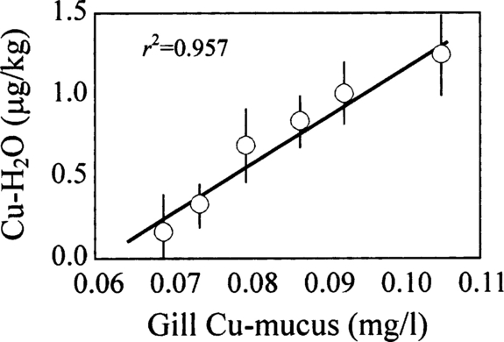
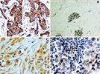
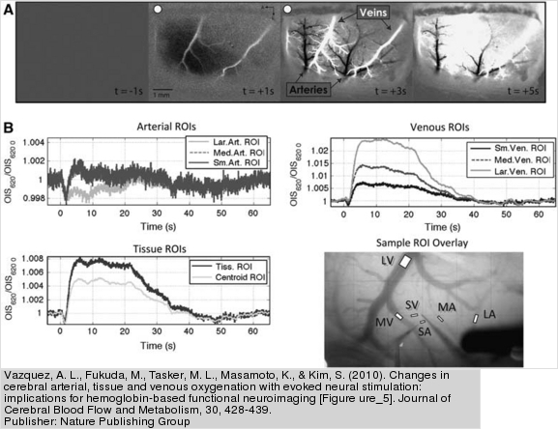
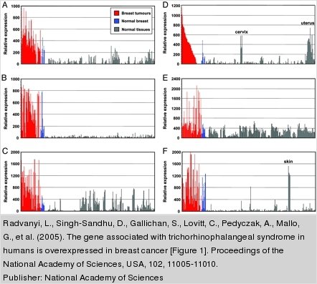
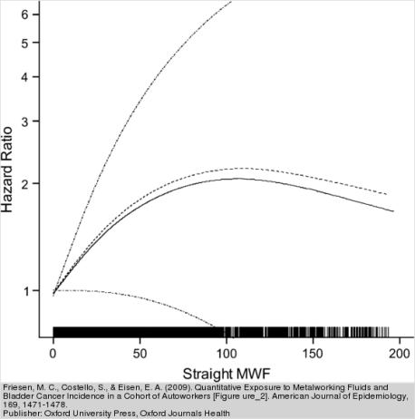
Aiding the Researcher: Deep Indexing of the Scholarly Literature
Deep indexing goes beyond traditional indexing and supplements it, by indexing each table and figure (images, charts, graphs, etc.) from within the article

Slide 8
Coming Soon to ProQuest biomedical databases: Unparalleled Discoverability and Efficiency
Beginning this Autumn, deep indexing records will be integrated as a standard part of the ProQuest biomedical aggregated databases
At launch:
ProQuest Medical Library will include
Deep indexing for nearly 1,600 journals
3.1 Million deep indexing records
ProQuest Health & Medical Complete will include
Deep indexing for more than 2,000 journals
3.3 Million deep indexing records

Slide 9
Coming Soon to ProQuest biomedical databases: Unparalleled Discoverability and Efficiency
Includes deep indexing of content from key publishers including:
Wiley-Blackwell
Cambridge University Press
Oxford University Press
Springer-Verlag
Elsevier Science
Sage Publications Ltd.
S. Karger AG
Nature Publishing Group
Human Press, Inc.

Slide 10
ProQuest Deep Indexing: Combined with powerful ProQuest resources in a single search
Deep Indexing | Search precision Uncover Hidden Data in Tables and Figures Innovative
Bibliographic Databases | Discipline Oriented Comprehensive Guide to the Literature Trusted
Full Text | Subject Specific Aggregated Cost Effective
Enabling new discovery paths in biomedical research

Slide 11
Thank you
Any Questions?

