Slide 1
SPRINGER SOLUTIONS
Informatiao Scientifica – Informatiao Medicata Conference – Budapest
September 22nd, 2011
Olga Alarcón
Licensing Manager – Health Market - Europe

Slide 2
AGENDA
Springer Today
SpringerLink: Ejournals, Ebooks
SpringerImages Database

Slide 3
SPRINGER TODAY

Slide 4


Springer Today: Some Key Facts
60 publishing houses in 20 countries
World’s second-largest STM publisher
Owned by private equity firms EQT and GCI
Revenues: > $1bn
5,000 employees
2,000 + journals and 5,500 new books each year

Slide 5
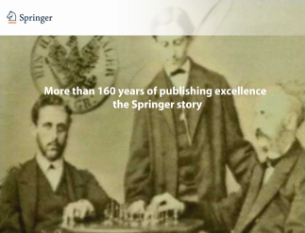



Springer’s product portfolio has changed from “books and journals” to e-products and databases
Merger
SPV/KAP
(2004)
Online Journal
Archives
(2005)
eBooks
(2006)
Springer founded in Berlin
(1842)
SpringerLink launched
(1996)
Protocols
(2008)
1000
1200
1400
1600
1800
1910
1930
1950
1970
1990
2001
2003
2005
2007
0
1100
1300
1500
1700
1900
1920
1940
1960
1980
2000
2002
2004
2006
2008
Centuries
Decades
Years

Slide 6
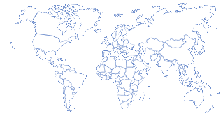
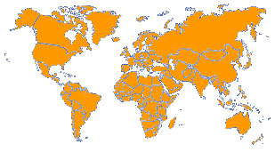




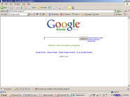


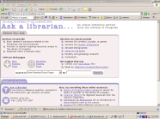

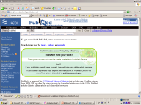
Springer is evolving into an electronic publishing house, where journals and books are published and delivered online
Paper subscription model
Database model: 24/7 access
II
Google Scholar directs the scientist to Springer’s repository
Journals
OJAs
eBooks
OBAs
Images
Protocols
BMC papers
Wikis
I
Scientist is looking for relevant literature, typically in Google Scholar

Slide 7
SPRINGERLINK:
  E-journals
  E-books

Slide 8



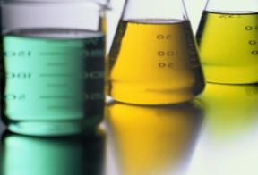
SpringerLink
SpringerLink provides access to outstanding STM content, with sophisticated search tools to:
  Nearly 2,000 Journals and their archives – Over 300 titles in Health Sciences
  More than 40,000 eBooks – Over 1.800 ebooks in Medicine (THE LARGEST MEDICINE EBOOKS COLLECTION)
  170 Online Reference Works
    This all totaling more than 4.8 million contributions

Slide 9
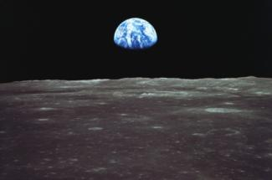

Librarians prefer SpringerLink…
Because it is simple, scalable and flexible, helping serve their users more effectively with:
  Fast access to more than 4 million documents from one integrated platform
  Enhanced user interface and functions based on an extensive usability research
  Preview of documents before downloading with look inside feature
  Powerful search engine which explores across all content
  Semantic Linking delivering more related documents with every search

Slide 10
Top 15 journals by Impact Factor

Slide 11
Top 15 Journals by Usage

Slide 12
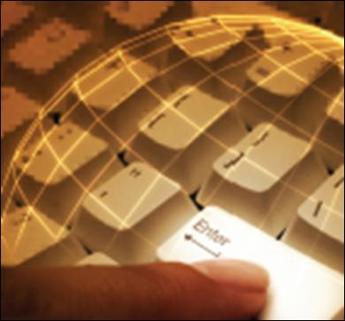
SpringerLink also provides you
  Enhanced personalization features
  SpringerAlerts for users and librarians and RSS feeds
  Access control via IP address or User Name/Password
  Pay-per-use for Journal articles
  Worldwide Help Desk available 24/5

Slide 13



SpringerLink serves users worldwide
SpringerLink currently serves:
  600 Consortia
  35,000+ institutions
  More than 600,000 publication alert subscribers

Slide 14
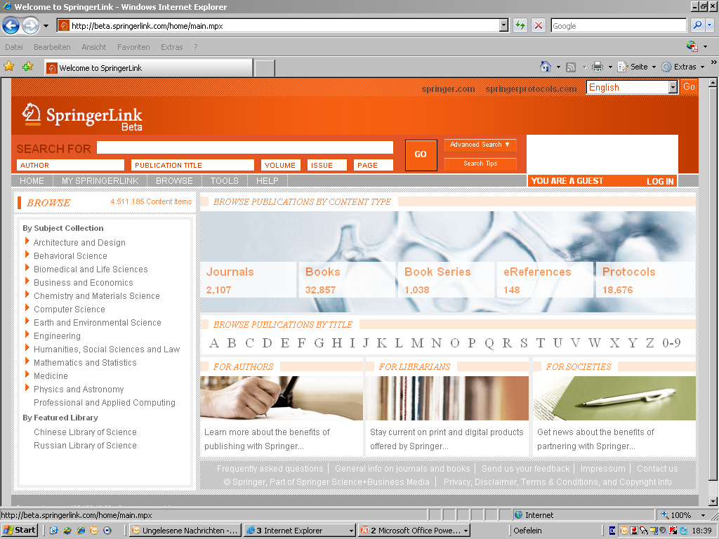
SpringerLink eBooks
Nearly 40.000 eBooks!

Slide 15
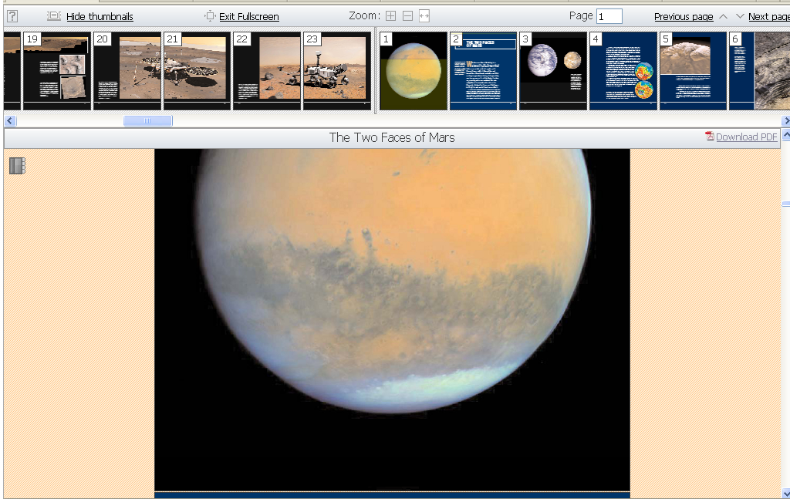
PDF Preview in Full Screen View
Notes:
You can also enlarge the view to the full screen.

Slide 16

Springer eBooks free of Digital Rights Management:
Print
Unlimited printing of all books
Save
Save in HTML format or PDF
Share:
Inter-Library Loan (print)
Course Websites
International Copyright Laws
Save on PCs, laptops, Handhelds, eReaders, etc
Email to fellow patrons
Visitor who is “authorized user“ can download chapters

Slide 17
Top Used Medicine Ebooks

Slide 18
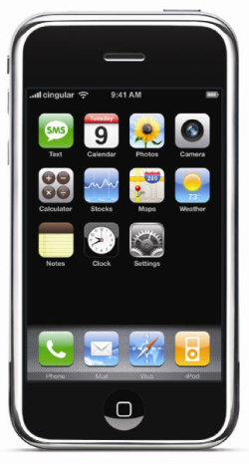
Mobile Device Support
Amazon Kindle, iRex readers, Sony Readers, BeBook, Cybook, ( ie large screen – dedicated eBook readers):
  All support PDF
  Can be used with our content
  Simply connect them to a PC
  Go to SpringerLink
  Find and Download the eBook chapters
  And save the PDF(s) on the device

Slide 19


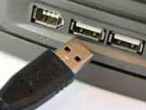
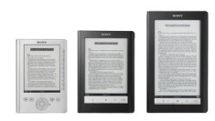
SpringerLink eBooks are compatible with mobile readers
Find
Browse and find content on SpringerLink.com
Download
Download the PDF documents you need
Connect
Connect your mobile device to USB port
Save
Save the PDF files on your reader:
Read
Read the content on your mobile device
(Sony Reader, iLiad, Kindle, etc)
“removable storage disc in Windows Explorer “(PC)
“separate drive in Finder” (Mac)

Slide 20
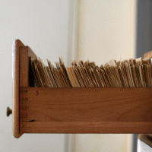
MARC Records
Springer MARC records:
Initial load via custom MARC batch from our Marc team, comes with purchase
Marc Updates, email alerting on monthly basis, sign up
MARC Newsletter, dedicated to catalogers, sign up
Support: www.springer.com/marc
OCLC records:
Freely available, Springer covers costs for all libraries
Enhanced records (LOG call nr. + advanced subject class. + 10 ISBN..)
Download from www.oclc.org World Cat Collection Sets Service
Records Available four weeks after Springer MARC records
Support - local OCLC representative

Slide 21
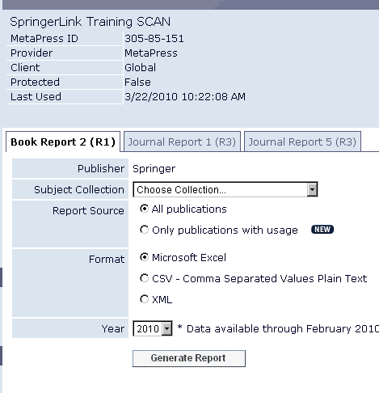
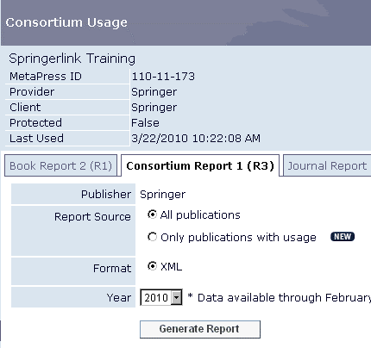
Stats: Download Counter Report
1. Book Report
2. Consortia Report

Slide 22
Alerting Services + Promotional Tools
Alerting Services
Monthly Marc Updates
Monthly eBooks title updates
Marc Newsletter for catalogers
Library Zone newsletter for general news
RSS feeds for new titles
Promotional Tools (Tips for driving usage)
Announce new key titles on library website (subject pages, blogs, Twitter)
Visit Library corner on Springer.com/librarians, “Tools & Services”
Additional promo pieces to promote new eBook holdings, banners, emails templates.
Participate in Google Scholar’s “Library Links” program
Place Google Scholar search widget on library website
http://libguides.bibl.hj.se/content.php?pid=23502&sid=202108

Slide 23



Digital Preservation
Springer arrangements with five vendors:
Portico, CLOCKSS, LOCKSS, GNL, KB
Content is being continually added to vendors
Reasoning for digital preservation:
a. Ensure continued user access in case of “trigger event”:
Publisher no longer exists
Specific content no longer hosted online
Natural catastrophe hinders access
b. Preserved content is migrated to up to date formats.

Slide 24
SPRINGER IMAGES DATABASE

Slide 25
Why does a scientific image database matter?
Because often, researchers are looking for answers to specific questions…
…and those answers are in the images
Notes:
With images we mean all kinds of ‘visuals’, e.g. photos, illustrations, tables, charts, histograms within an article, book chapters et cetera. These images mostly show the essence of the research.

Slide 26



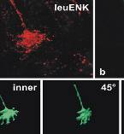



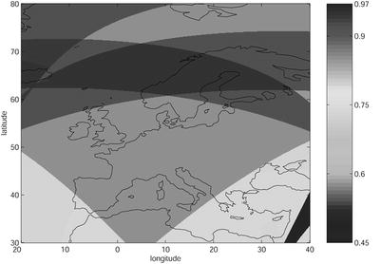
Where SpringerImages adds value
Traditional method of finding an image
14,726 results
no
Image found?
yes
Repeat to find more
Search
Scan results
Download article
Scan article
Finding images via SpringerImages
Reseachers….
Find more images
Find them easier
Get answers faster
14 results
Search
Scan images
Get answer

Slide 27




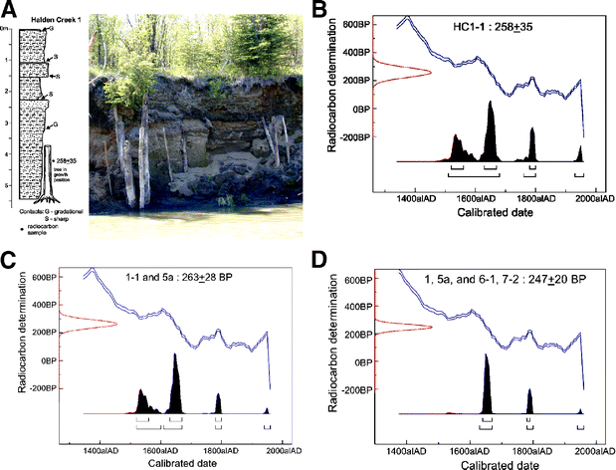


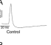
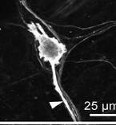


What is SpringerImages?
A database of over 3 million images and associated pieces of full-text from Springer publications and third-party scientific image sources Images
Images include: drawings, photos, tables, charts, videos, etc.
Springer Journals
biology image library
Open Access
Springer Books
Notes:
Biological Image Library (BioMed Central, biologyimagelibrary.com): Available after the launch.
Description: The library is a collection of images, illustrations, movies and animations that are useful for research and education. It is also a new, easy way to share your work with others without losing any rights to it or limiting how you use it in the future.
Images.MD (Current Medicine Group, images.md)
Description: images.MD compiles over 70,000 high-quality images spanning all of internal medicine, all derived from Current Medicine Group LLC’s renowned series of illustrated atlases. Each image is accompanied by detailed and informative text written by over 2,000 contributing experts.

Slide 28
All science image database – purchase options
Two purchase options
SpringerImages (Complete)
SpringerImages: Medical & Life Sciences
SpringerImages: Medical & Life Sciences includes following subject collections:
Biomedicine
Life Sciences
Medicine & Public Health
Pharmacy

Slide 29
What may users do with the images
Subscribers have unlimited personal use of the images for the life of their subscription. This covers lectures, presentations, research, et cetera - any non-commercial use.
You cannot publish or use the images commercially, in print or online, without acquiring standard permissions through the Springer’s permissions departments.

Slide 30
Image permission examples
Within license
Request permissions needed
Teaching professor uses image in a course or lecture
Researcher gives presentation at a conference
Reseacher uses image in their thesis
Image is put into a coursepack which is given for free to students
Researchers uses image in an article or book which will be published
Images being used for promotional material, e.g. folder
Images being used for trainings or slide kits

Slide 31

Thank You!
Questions?
Olga Alarcón
olga.alarcon@springer.com
www.springer.com

