Slide 1
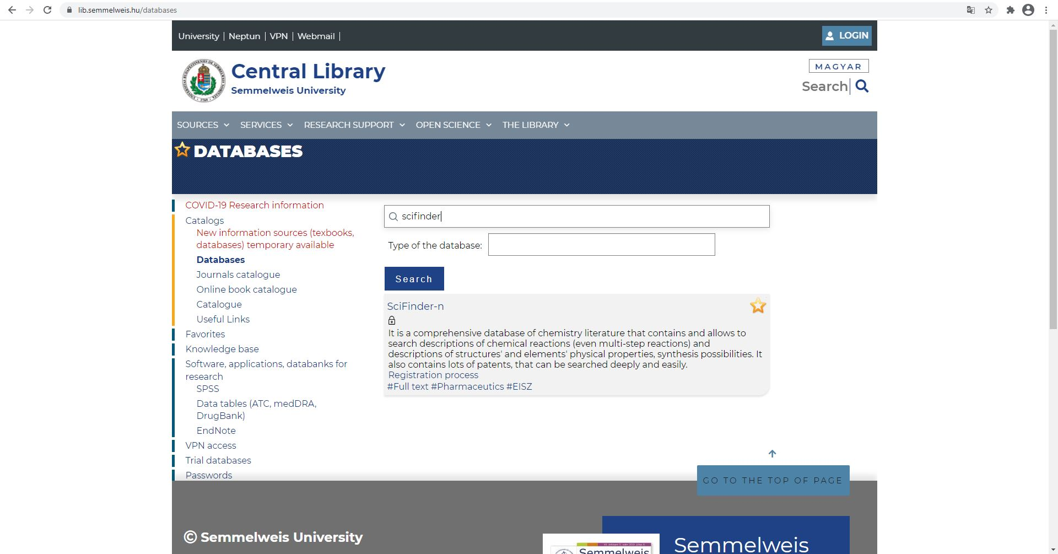
Getting started with SciFinder-n database
On our library's website, at the Databases menu, search for SciFinder.

Slide 2
Getting started with SciFinder-n database
Custom registration is required to use SciFinder-n.
Click on the "Registration process" link.

Slide 3
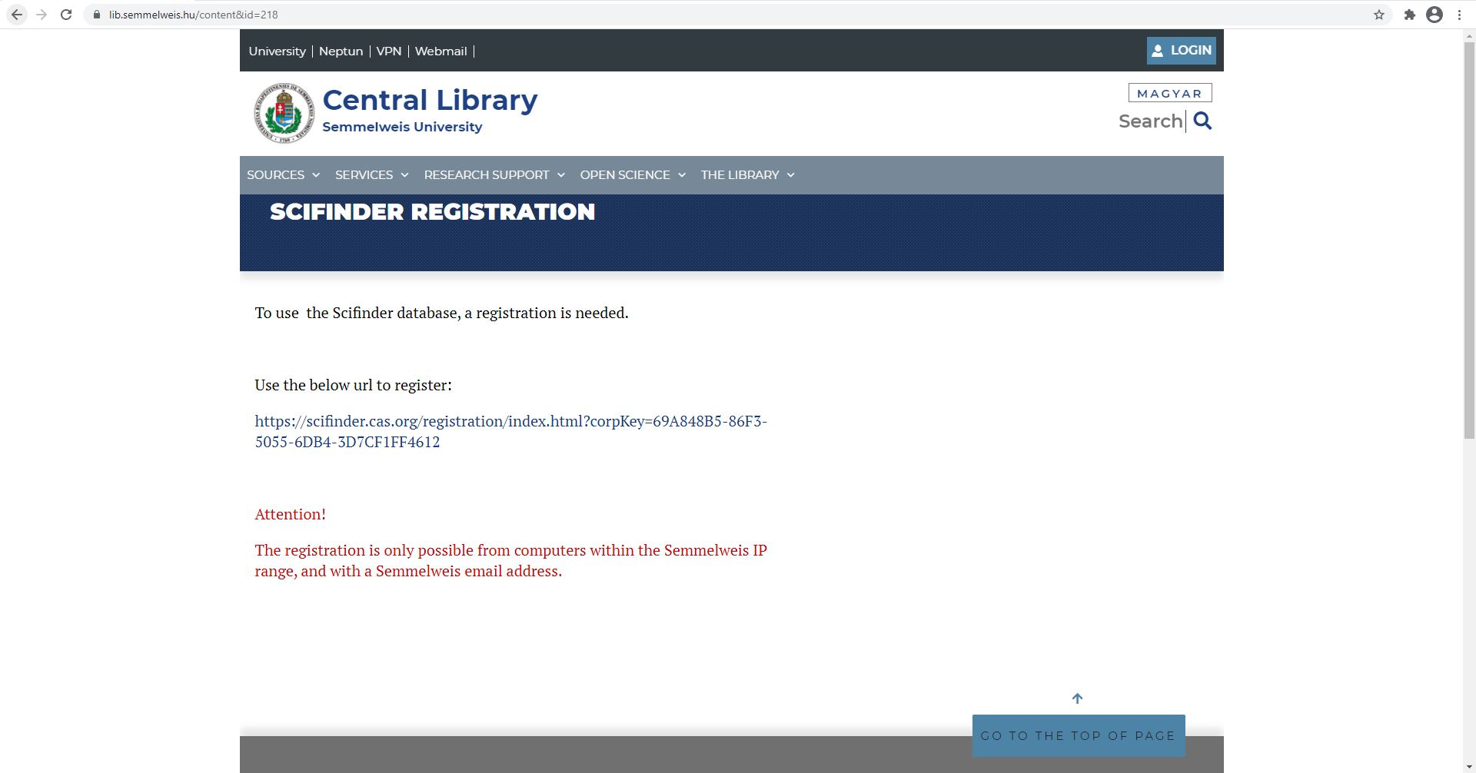
Getting started with SciFinder-n database
Registration is only possible within Semmelweis IP range and by entering a university email address.
Click on the link to register.

Slide 4
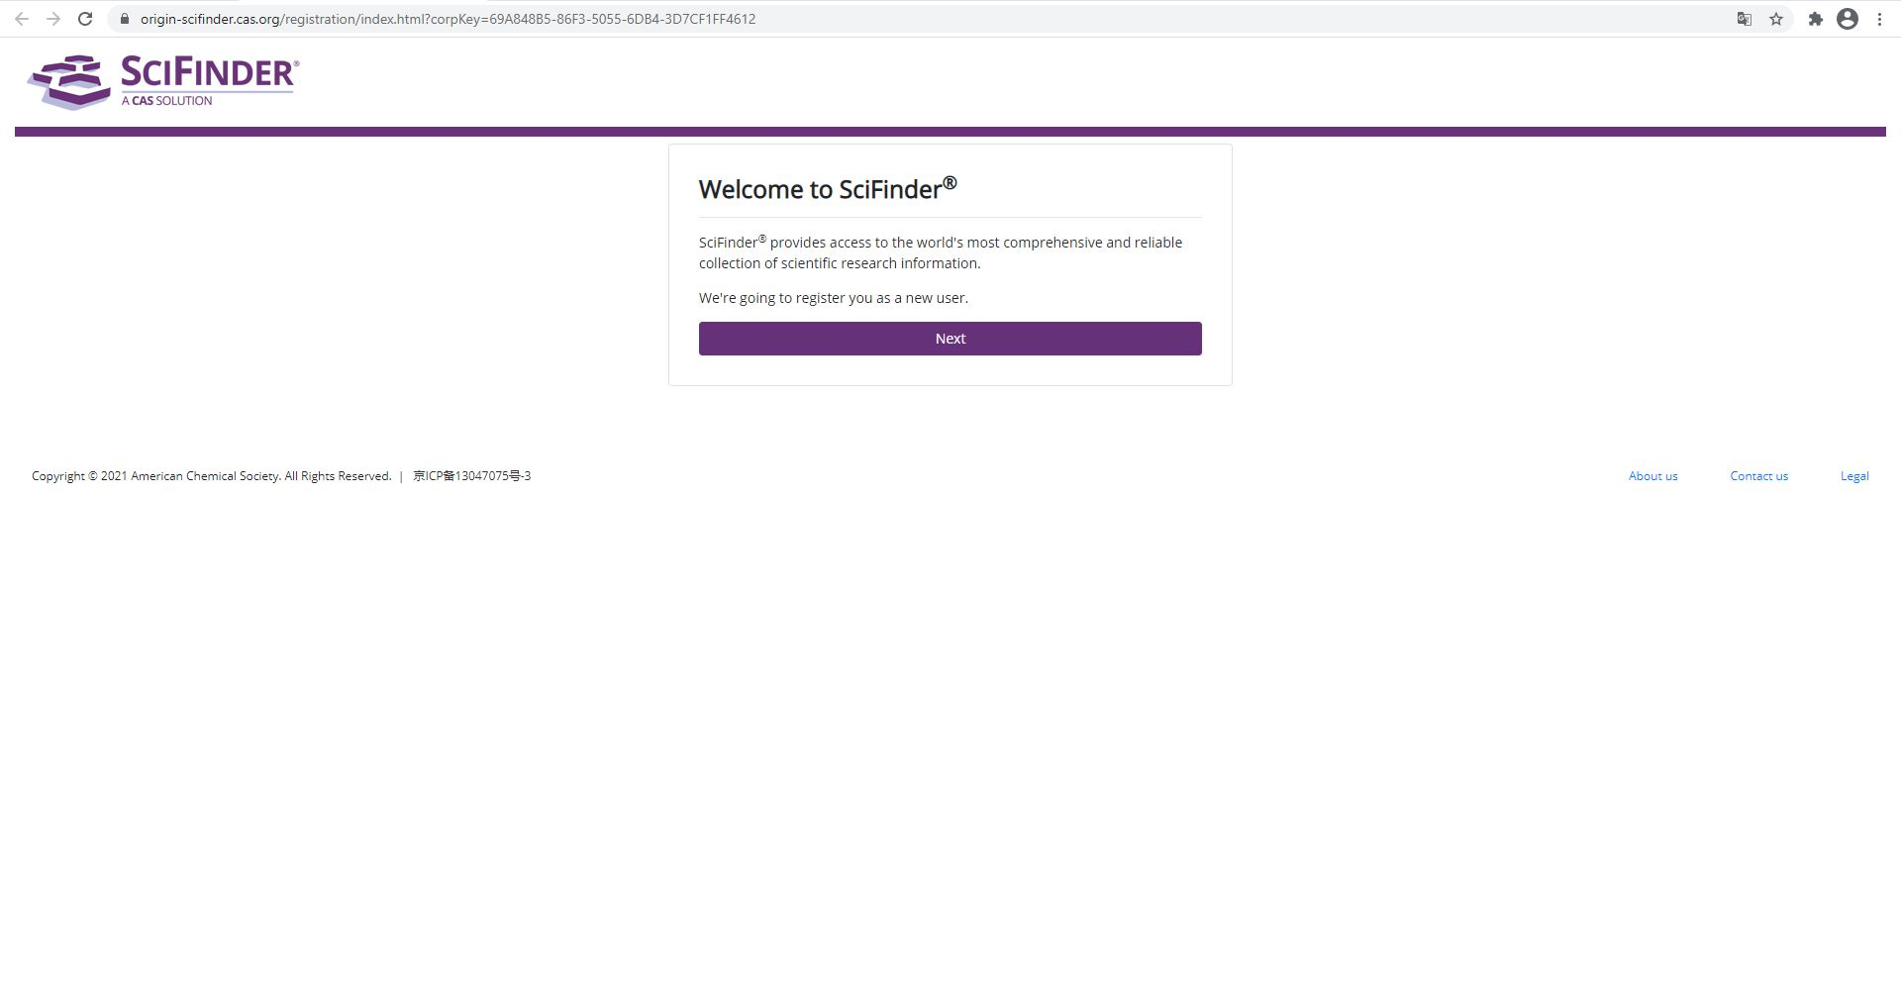
Register on SciFinder-n
On the website of SciFinder-n, click “Next” to start the registration.

Slide 5
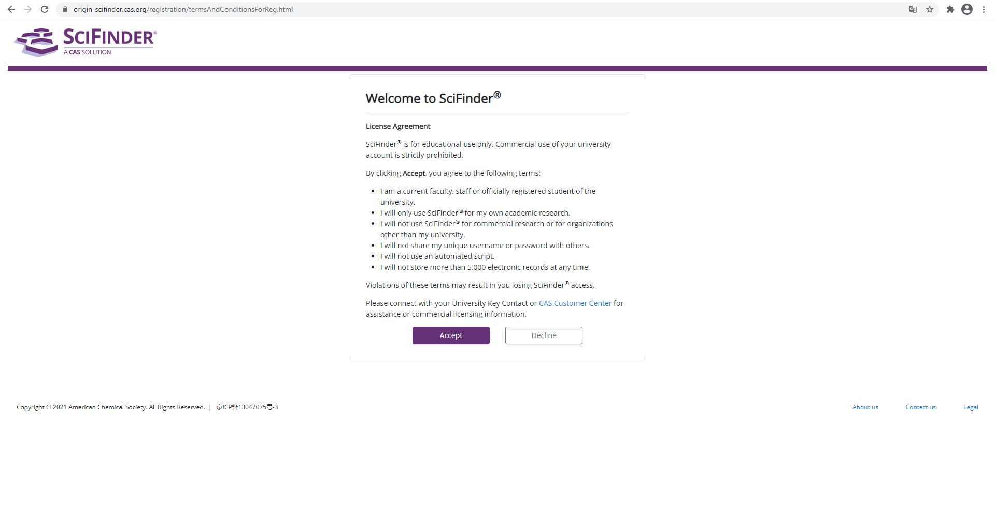
Register on SciFinder-n
Please accept the License Agreement.

Slide 6
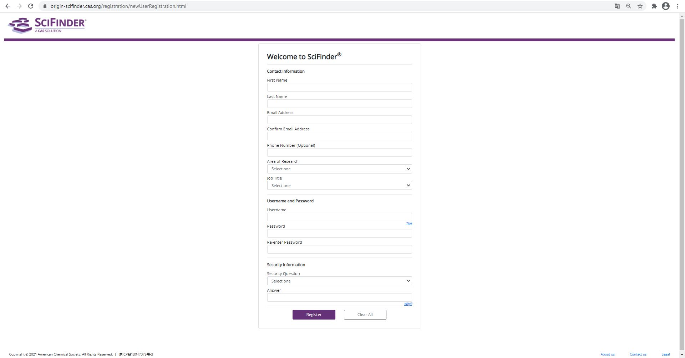
Register on SciFinder-n
Fill out the form with your informations.
Be sure to use your Semmelweis University email address.
Then click on the "Register" button.

Slide 7
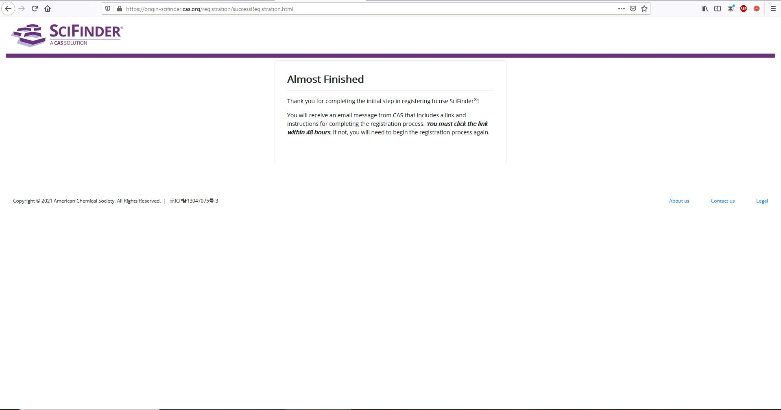
Register on SciFinder-n
The system has sent a confirmation email, check your University email inbox.

Slide 8
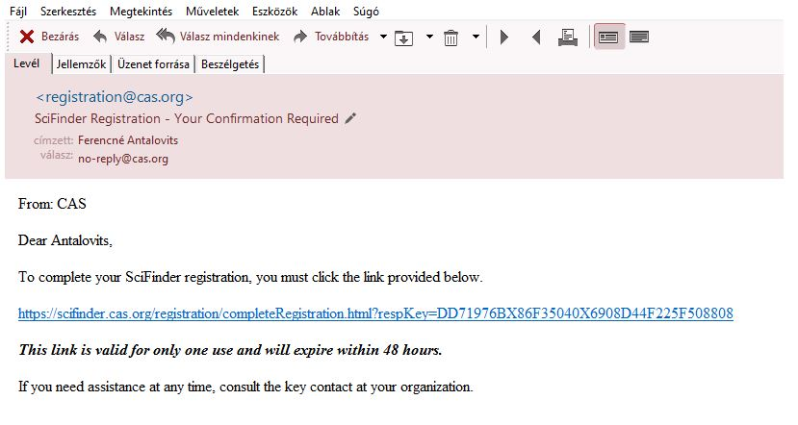
Register on SciFinder-n
Click on the link in the email to confirm your registration.

Slide 9
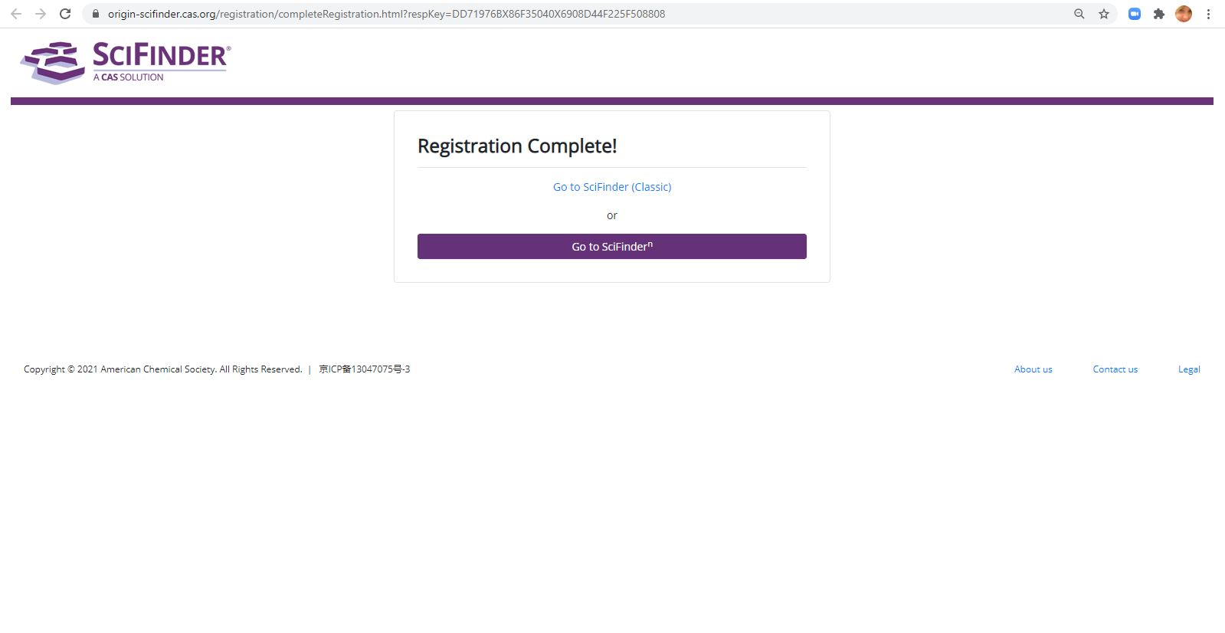
Register on SciFinder-n
The registration was successful, you may now use SciFinder-n.

