Slide 1
The Springer eBook Collection
Cem Üzüm
Licensing Manager Central Europe
25th of September, Budapest

Slide 2
Agenda
What is an eBook?
Perception of eBooks, and how are they used?
eBook usage and discoverability
Innovations: eBook readers
Springer eBooks: business models and features
Summary & Conclusions

Slide 3
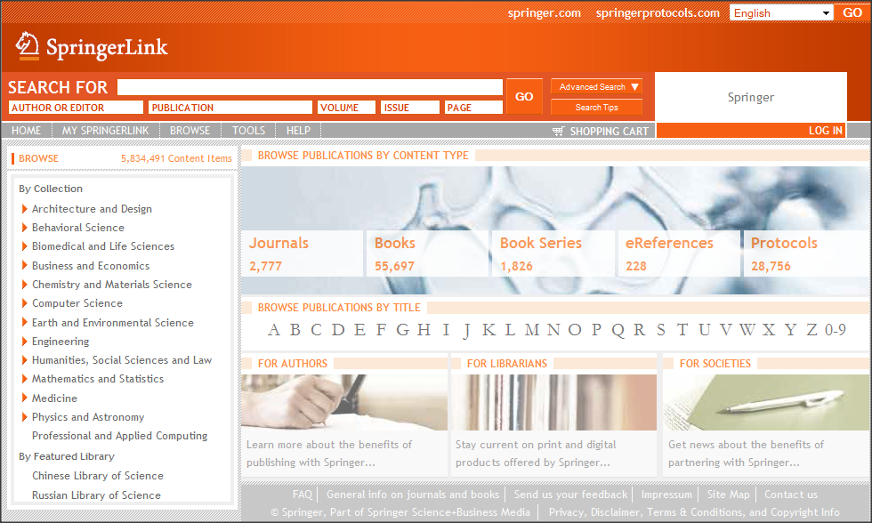
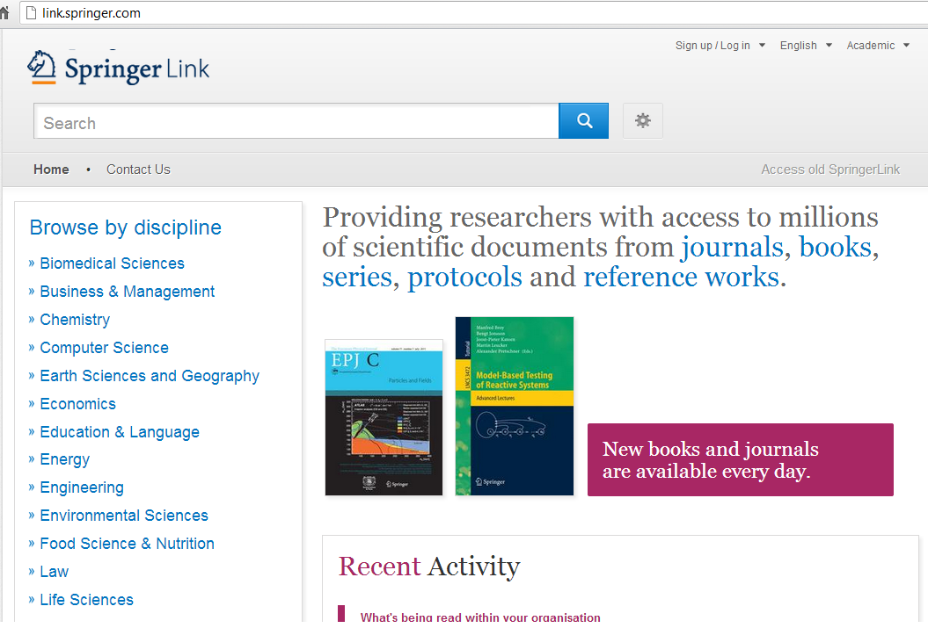
Springer: over 88,000 eBooks!
New URL: link.springer.com
Notes:
eBooks + SBA=88K+
Training on the new SpringerLink available too

Slide 4
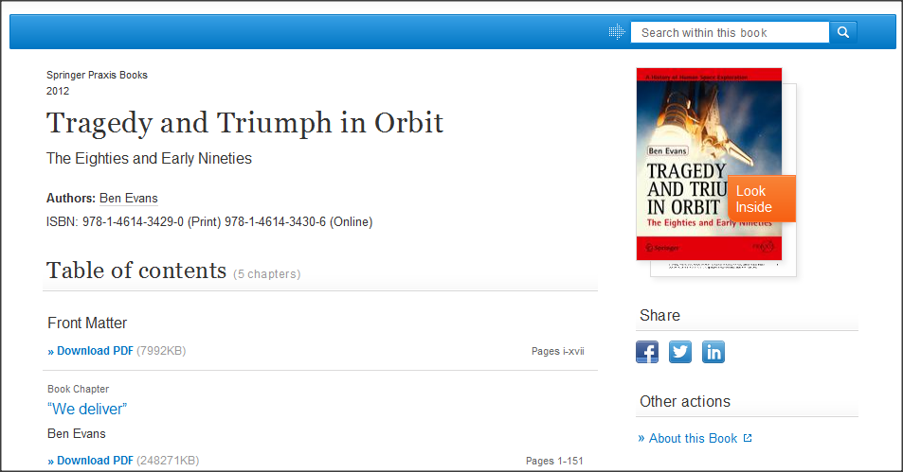
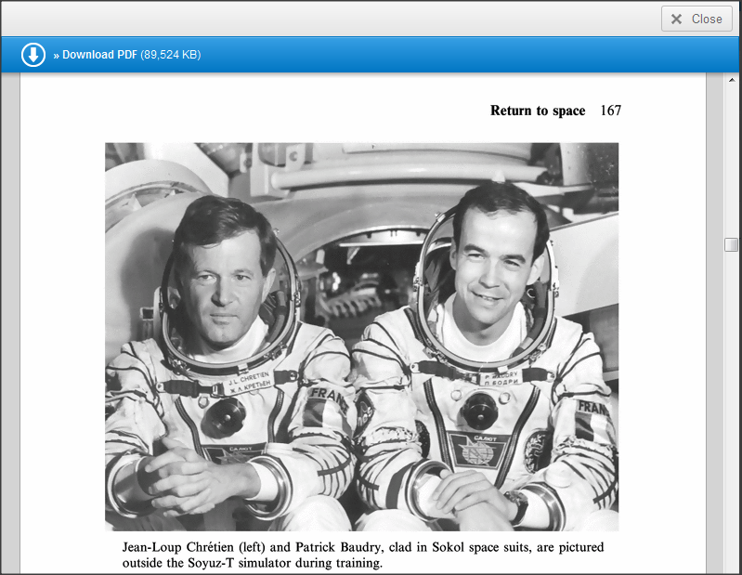
This is a Springer eBook
Notes:
LookInside

Slide 5
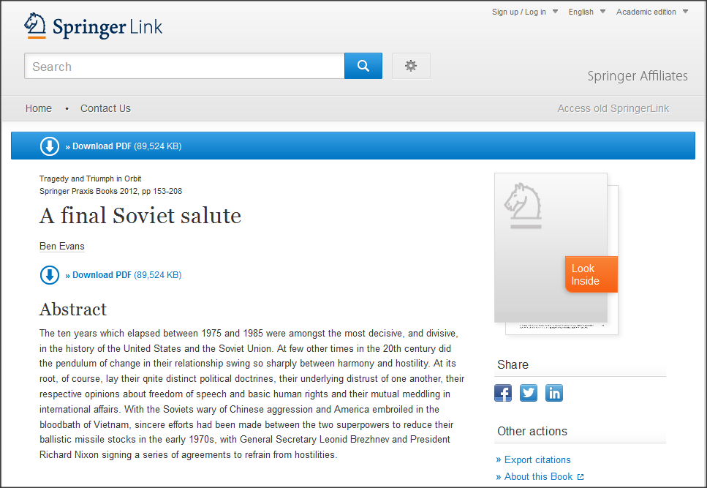
SpringerLink – eBook LookInside
No special software is required
Two pages of chapters (and all Front & back matter) are freely available to all
Notes:
>>Need updated LookInside statement
Now let’s talk about eBooks.
“Look Inside” makes it possible to preview all chapters of an eBook without the need to open a PDF. Even non-subscribers see all frontmatter and a small portion of content for each chapter. No special software is required, so there is nothing for an enduser to download or update. All controls are contained within the site!
“Look Inside” puts chapter-level PDFs back together putting the book experience back into eBooks.

Slide 6
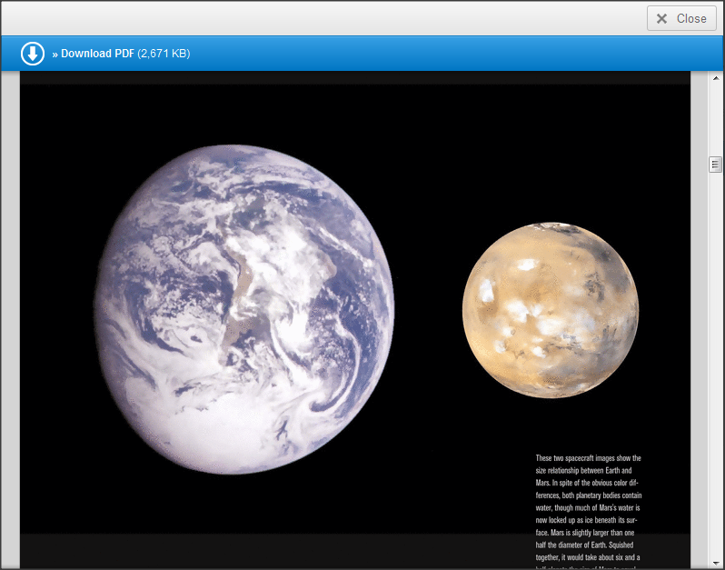
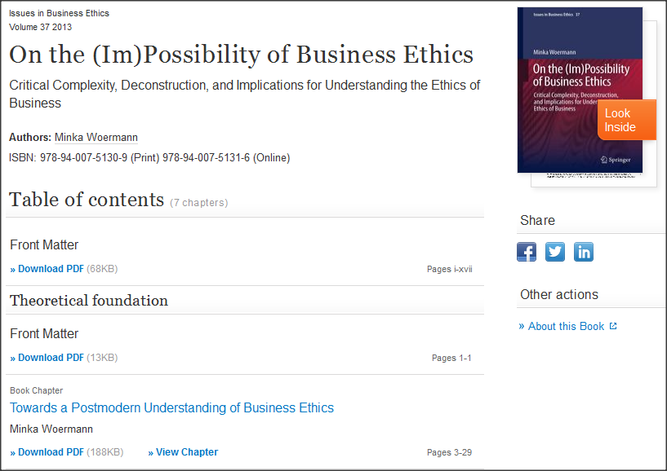
SpringerLink eBooks-continued
Notes:
Color, html
You can also enlarge the view to the full screen. –not true anymore, right??

Slide 7
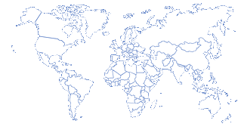
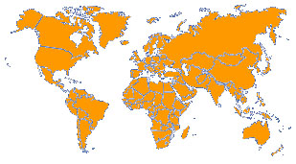
Unlimited access to eBooks
Every end user to have unlimited 24/7 access, when and where ever they want, to enhance the role scientific literature plays in the research process.
Paper model
Online database model
eBooks accelerate research

Slide 8
Win-Win situation in the eBook market
Researchers
Easier to search
Convenience
Easier to cite
Libraries
More content/service
Attractive discounts
Saves shelf space
Greater usage
Reduced handling costs
Authors
Benefits
Wider distribution
Online First
Increased usage
Global readership
Lower distribution costs
New market opportunities
Better Marketing efficiency
Publisher

Slide 9
Leading Publishers: Number of Books Published
Number of English-Language Titles Published in 2011
4,734
3,959
2,272
1,578
1,457
1,308
1,077
725
239
(Data from www.puballey.com and publisher websites; if a book is published simultaneously in hard- and paperback editions, only the hardback edition was included)

Slide 10
eBook Collection
Springer’s eBook Collection includes the following content types:
eBooks
Textbooks, Monographs, Atlases, and more
eReference Works
Handbooks and Major Reference Works
eBook Series
Organized into 12 + 5 Subject Collections
~ Available on SpringerLink

Slide 11
Key Features for Librarians
Interconnected to all Springer content (Online Journals and eReference Works)
New books directly available for use: Springer Books are born digitally
Fully integrated in your library catalogue: MARC 21 Records
Allowances for digital ILL, inclusion in course packs, etc COUNTER compliant usage statistics
Ownership business model

Slide 12
Availability
Springer eBooks are available through SpringerLink*.
Subscriber access is gained through IP verification for institutions and passwords/usernames for individuals and society members.
Packages can be purchased direct via your consortia and licensing manager; individual institutions can purchase via their book distributor, journal agent, or direct via Springer.
A la carte purchases can be made through any number of partners including Amazon, NetLibary, eBrary, MyiLibrary etc….
~ Available on link.springer.com
* Local hosting/loading agreements are possible

Slide 13
2012 Chapter Downloads by Copyright Years
Although a book title is used slightly less a few years after publication, there is definitely strong interest in ‘older’ book content.
For example, chapters from an English language 2005 title were downloaded 755 times on average in 2012. This compares to ‘just’ 1,142 chapter downloads for an average 2011 title.
2012 titles had slightly fewer downloads on average, since many titles were added to SpringerLink only in the course of the year.
English Language Packages: Average Chapter Downloads 2012 by Title and Copyright Year
(Data adjusted for abnormal usage spikes due to massive downloading)

Slide 14
eBooks Downloads by Visitor Referral
eBooks downloads by visitor referral Q1 2013
Direct traffic includes every session for which no referrer was passed on, such as bookmark traffic and typed URLs, but more importantly, word-to-mouth initiated traffic such as links in e-mails or instant messaging programs

Slide 15
MARC Records
Option 1: Basic Springer MARC Records
Provided free
Available on www.springer.com/marc in UTF8 format
Option 2: OCLC MARC Records for Springer eBooks
Collection Sets freely available
Download records using OCLC control numbers
Option 3: 3rd Party MARC Records for Springer eBooks
Not necessarily free
E.g. Serials Solutions
Notes:
15

Slide 16
Springer eBooks: NO Digital Rights Management (DRM):
Print
Unlimited printing of all books
Save
Save in HTML format or PDF
Share:
Inter-Library Loan (print)
Course Websites
International Copyright Laws
Save on PCs, laptops, Handhelds, eReaders, etc
Email to fellow patrons
Visitor who is “authorized user“ can download chapters

Slide 17
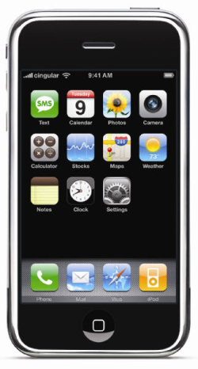
Mobile Device Support
Amazon Kindle, Sony Readers, BeBook, Cybook, ( ie large screen – dedicated eBook readers):
All support PDF
Can be used with our content
Simply connect them to a PC
Go to SpringerLink
Find and Download the eBook chapters
And save the PDF(s) on the device

Slide 18
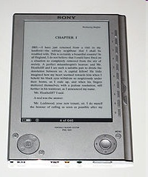
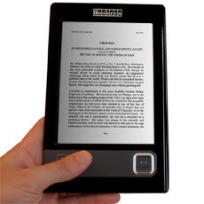
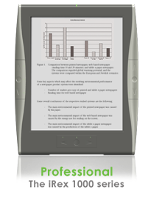
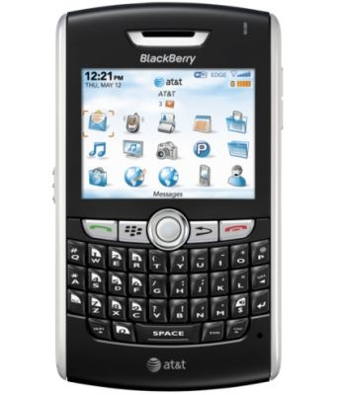
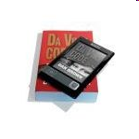
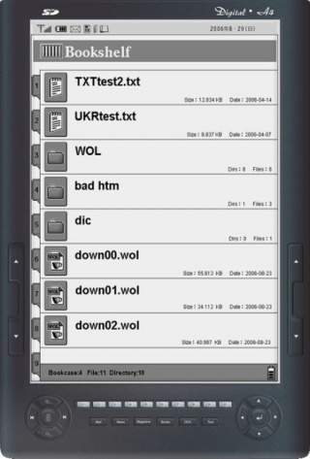
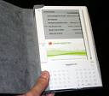
eReaders – the future of reading?

Slide 21
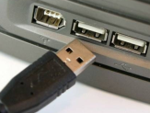
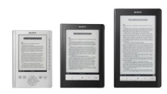
SpringerLink eBooks are compatible with mobile readers
Find
Browse and find content on SpringerLink.com
Download
Download the PDF documents you need
Connect
Connect your mobile device to USB port
Save
Save the PDF files on your reader
Read
Read the content on your mobile device
(Sony Reader, iLiad, Kindle, etc)

Slide 22
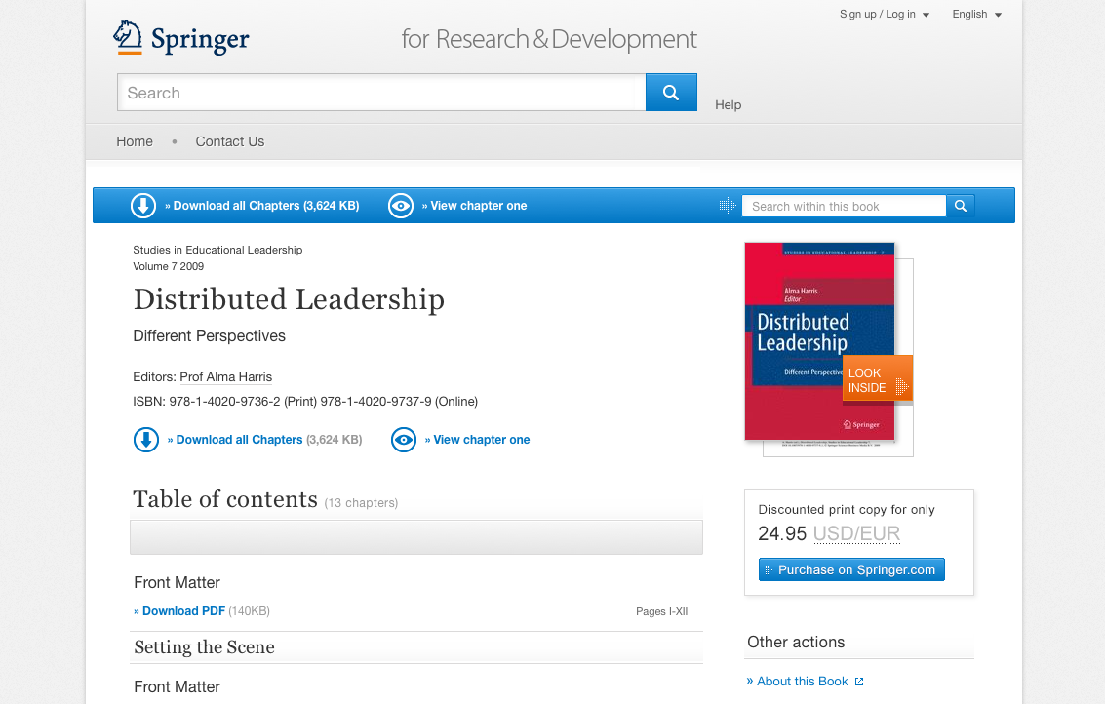
What is Springer’s “MyCopy”?
SpringerLink-users with access to Springer’s eBooks can order
print book from that collection
directly from SpringerLink
For only 24.95 EUR / USD (including shipping); changing to 24.99 soon
No extra charge and no extra work for the library
Notes:
Mention price change, springer.com checkout

Slide 23
What is Springer’s “MyCopy”?
Over 20,000 MyCopy eBooks (& growing)
POD-suitable eBooks ( limited page number)
copyright year –was 2005+ only; SBA is adding thousands more titles
English language titles only
Soft cover is 4-color and inner work is black & white
Standard price of 24.99 EUR/USD (including shipping & handling)
Available in most of Europe, USA and Canada (& expanding)

Slide 24
Branding MyCopy Books
MyCopy visual on book spine
MyCopy wordmark and SpringerLink logo on front cover

Slide 25
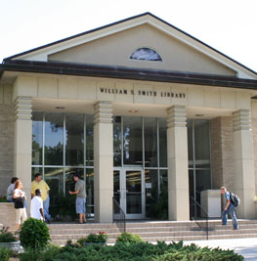
MyCopy
4
Springer passes order on to LSi
1
3
5
Springer sells eBook package with MyCopy order option to library
SL-users order MyCopy books*
Lightning Source prints, binds and drop ships MyCopy book
2
Library gives library patrons access to eBook packages
*NOTE: checkout is now on springer.com. Checkout no longer takes place on SpringerLink.
*Also, we are happy to announce we now take PayPal & Amex

Slide 26
Pricing
Annual subject specific packages, available per package (Subject Collection)
We have options for academic institutions and corporations with a single site or multiple locations.
Springer offers a number of tailored license options, based on research intensity and number of patrons.
Progressive discounts when more collections or copyright years are purchased
Consortia discount available

Slide 27
Summary - Springer eBooks Collection is:
Over 7000 new eBooks every year
12 subject collections (English / Intl)
5 subject collections (German)
Critical content
100% DRM Free
Unlimited use: available 24/7
Fully Searchable
Perpetual access – archival rights
Highly used – excellent ROI

Slide 28
Thank You! – Questions?
Cem Üzüm
Cem.uezuem@springer.com
Tel.: +49(0)151 14747869

