Slide 1
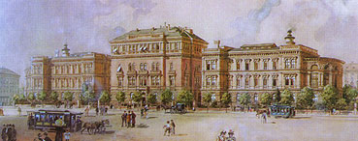
SpringerLink
Training Guide for the new Springer platform
Nora Schneider,
Account Development Central Europe
Notes:
Welcome
• Introduction of trainer
• Explain agenda: goal of this training, 60 minutes, switching between live and slides
• How to handle questions during training

Slide 2
URL
http://link.springer.com

Slide 3
Content
Homepage
Search Results
Product Pages
Book

Slide 4
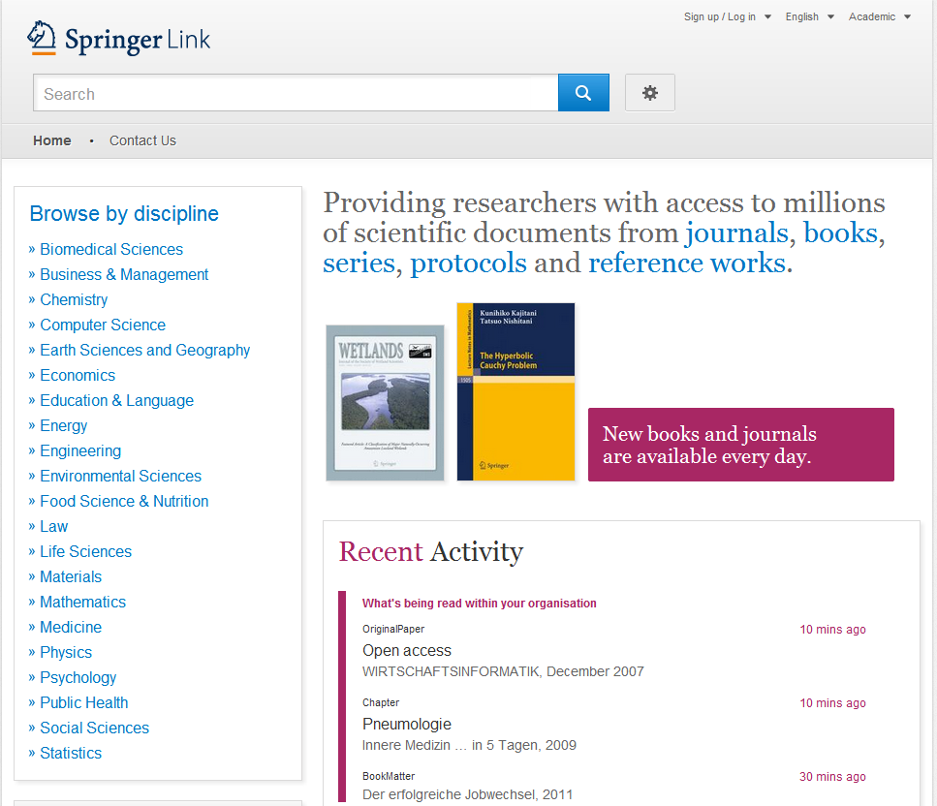
Homepage
Homepage
Divided into 3 parts:
Search functionality
Browse functionality
Content offered according to your profile
Search
Browse
Content
Notes:
Explain 3 areas
Let’s go over three areas one by one in more detail

Slide 5
Homepage
Organisation Logo
For organisation users there is the possibility to integrate a organisation logo within the header.

Slide 6
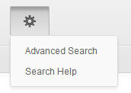
Homepage
Search
Most users access our content through the search functionality.
Therefore the search is the biggest and most prominent element on the page.
Advanced search and help functionality can be accessed by clicking the ‘settings wheel’

Slide 7
Homepage
Browse
You can also access our content through browsing. If you click on the topic of your choice you will end up on the search results page, showing all entries for this scientific discipline.
Sub disciplines can be chosen on the search results page as filter.

Slide 8
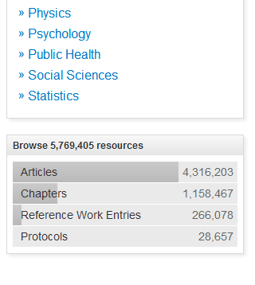
Homepage
Browse by type of content (1)
Below the sector of industry navigation you find a list of smallest content types:
(Journal ) Articles
(Book) Chapters
References Work Entries
Protocols
If you click into “Articles” you will end up on a search result list of all articles. You will find more filter options there.

Slide 9
Homepage
Browse by type of content (2)
On top of the content area you find an introduction text with bigger content units listed.
Journals
Books
Series
Protocols
Reference works
If you click into “Journals” you will end up on a search result list of all journals. You will find more filter options there.

Slide 10
Search Results

Slide 11
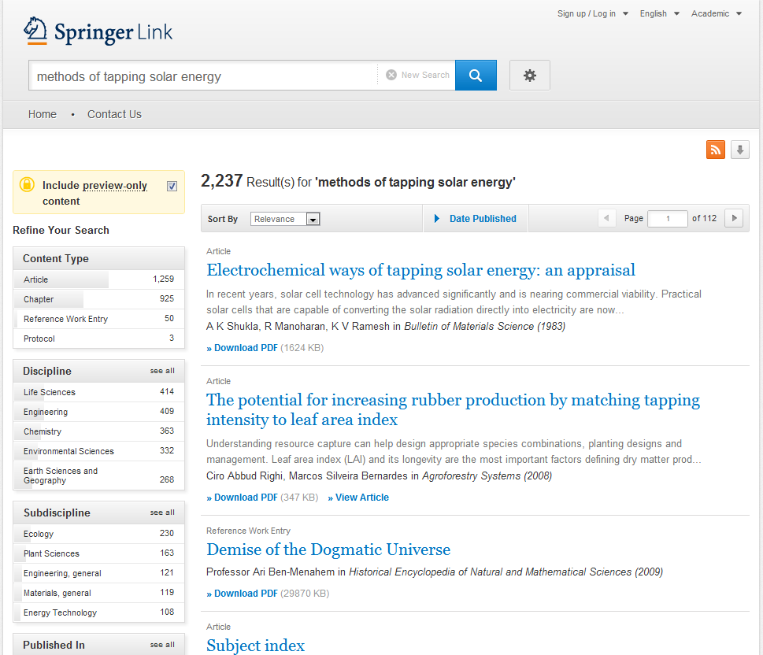
Search Result Page
Search Results
To the right you get your search results listed.
By default you get all results displayed, i.e. content you have licensed and preview-only content.
Notes:
Do basic search for “solar energy”
Pick suggestion: methods of tapping solar energy

Slide 12
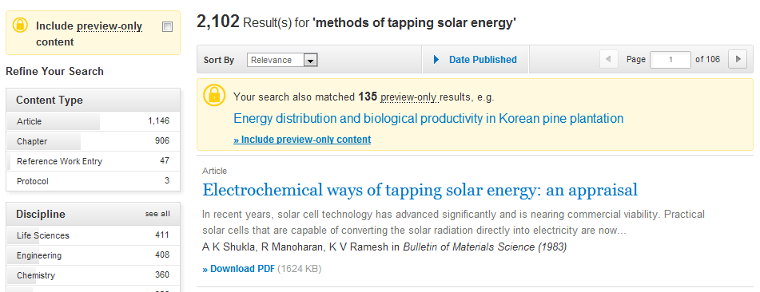
Search Result Page
Only see licensed content
If you like to see only content you are entitled to, you have to uncheck the yellow box above the search result filter options to the right.
Then only search results you have full-text access to will be listed.

Slide 13
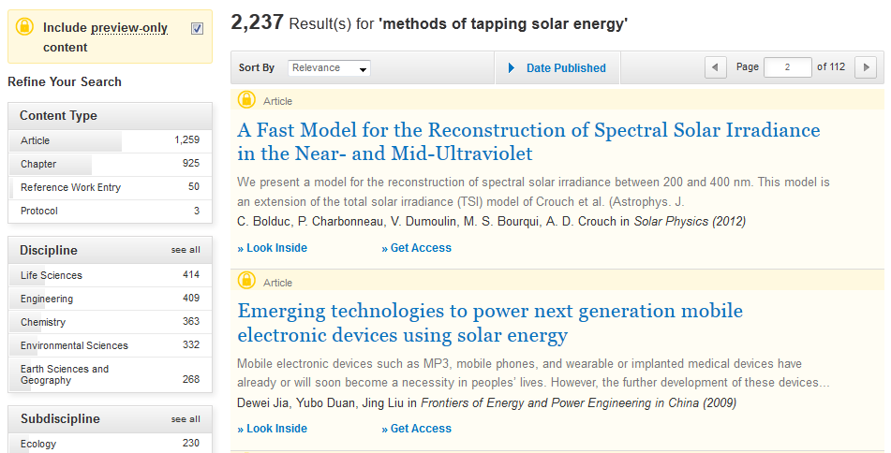
Search Result Page
(2)
Preview-only content
Preview-only results are displayed with the color yellow in the background (1).
If you only want to see only results you have access to, uncheck the yellow box above the search filters (2).
(1)

Slide 14
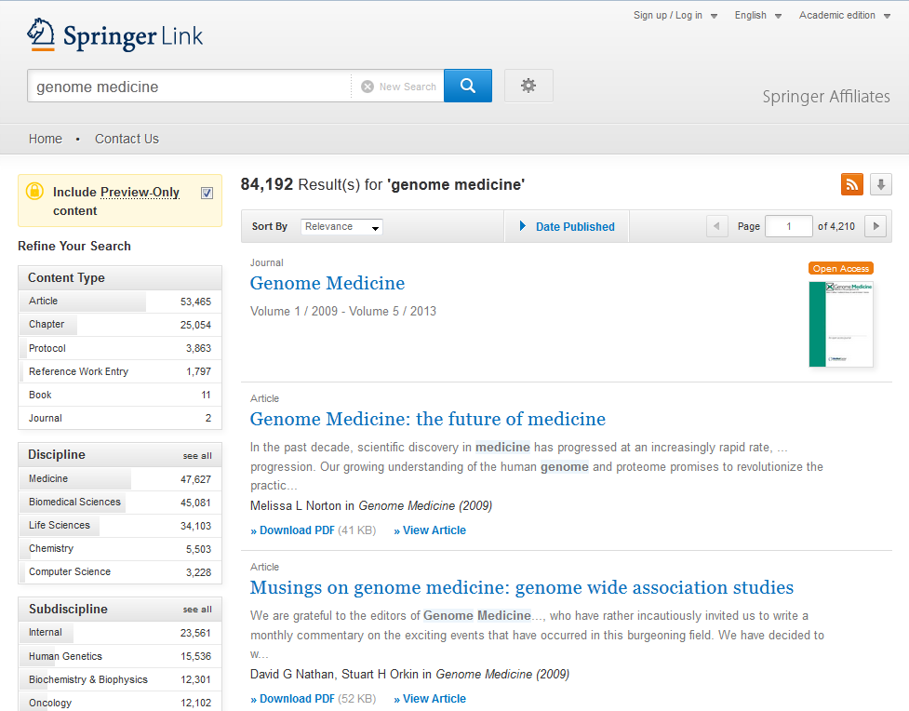
Search Result Page
Open Access Content Open Access content is indicated with an orange icon to the right of a search result item.

Slide 15
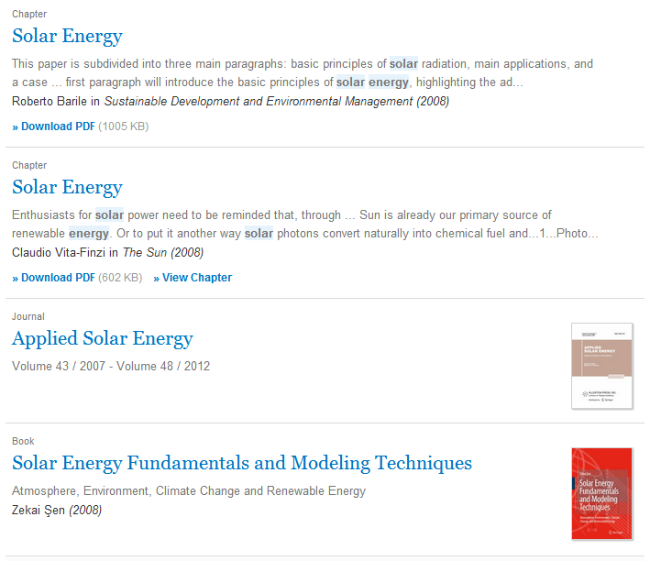
Search Result Page
(1)
Structure of list items within a search result page
Type of content (1)
Title of list item (2)
Description (3)
Author of list item (4)
Published in which product (5)
Download (full-text) PDF (6)
(2)
(3)
(4)
(5)
(6)

Slide 16
Search Result Page
(1)
Type of content
The following types of content may be listed in a search result (1):
Bigger Units
Series (of books)
Book (of chapters or protocols)
Journal (of articles)
Reference Work (of reference work entries)
Smallest Units
Chapter
Protocol
Article
Reference Work Entry

Slide 17
Search Result Page
Filter Options
To the left you will find predefined filter options that help you to optimize your search result.
The following filter options are available:
Content type
Discipline
Subdiscipline
Published in
Language

Slide 18
Book

Slide 19
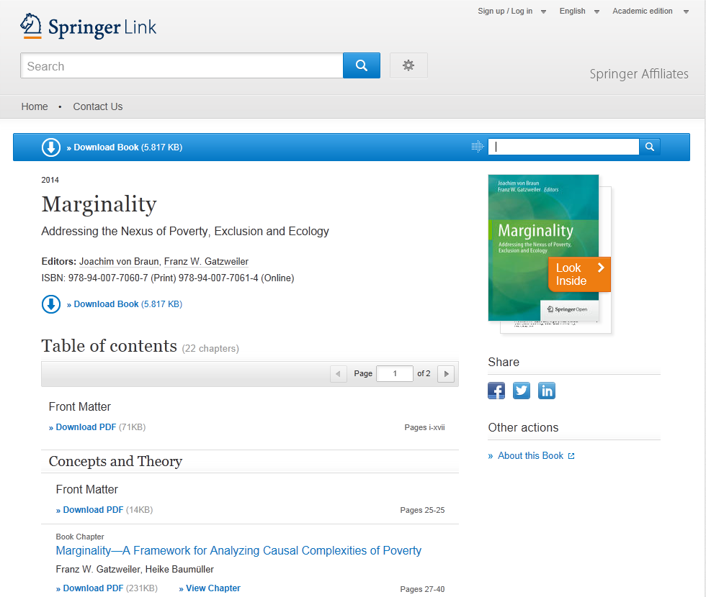
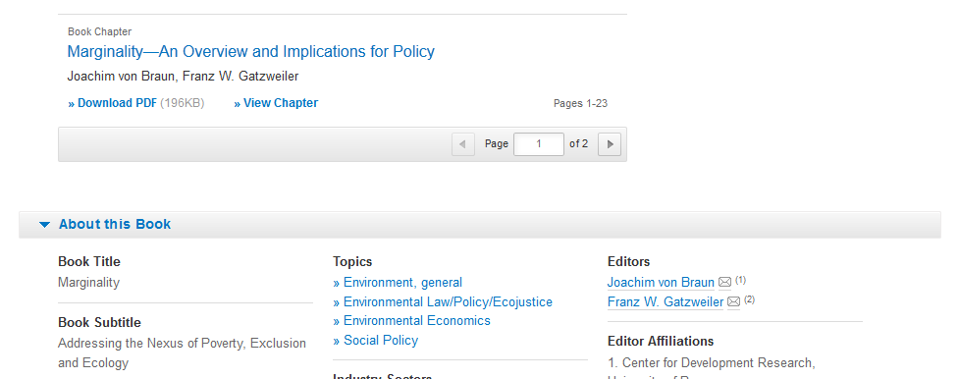
Book Homepage
Functionality Overview
Download book (1)
Search within this book (2)
Publication Year (3)
Book Title (4)
Book Subtitle (5)
Authors (6)
ISBN (7)
Table of contents with book chapter list items (8)
About this Book (9)
Link to book homepage on springer.com (10)
(1)
(2)
(3)
(4)
(5)
(6)
(7)
(8)
(10)
(9)

Slide 20
Book Homepage
Download book
You can download a pdf version of a whole book if you click on the download book link within the blue bar on top of the page if you have licensed that book.

Slide 21
Book Homepage
Search within a book
If you want to search for a specific keyword use the “search within this book” functionality on top of the page.
For the search result you will leave this page and end up on a search result page.

Slide 22
Book Homepage
Browse within a book
To browse through the chapters of a book you get a “table of contents” on the book chapters offered .
A list item to chapters supplies the following information:
Type of content (1)
Title of the chapter is linked to the chapter (2)
Author information (3)
Download PDF link to download the chapter if you have access (4)
(1)
(3)
(2)
(4)

Slide 23
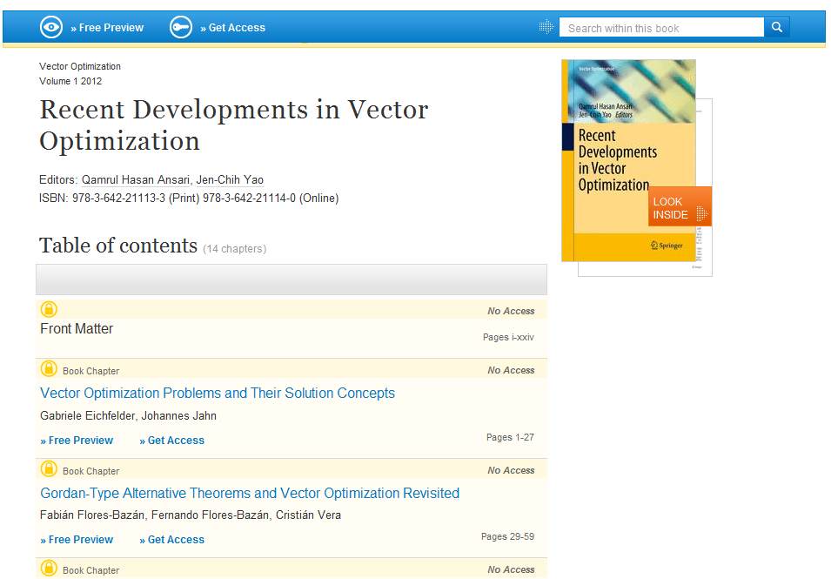
Book Homepage
No access to book
If you have no access to the book the table of content is displayed in a different design:
All list items will have a yellow background (1)
In front of the content type information a looked symbol is displayed (2)
Instead of a download link you get a “Free Preview” link offered as well as a link to “Get fulltext Access to the chapter” (3)
(1)
(2)
(3)

Slide 24
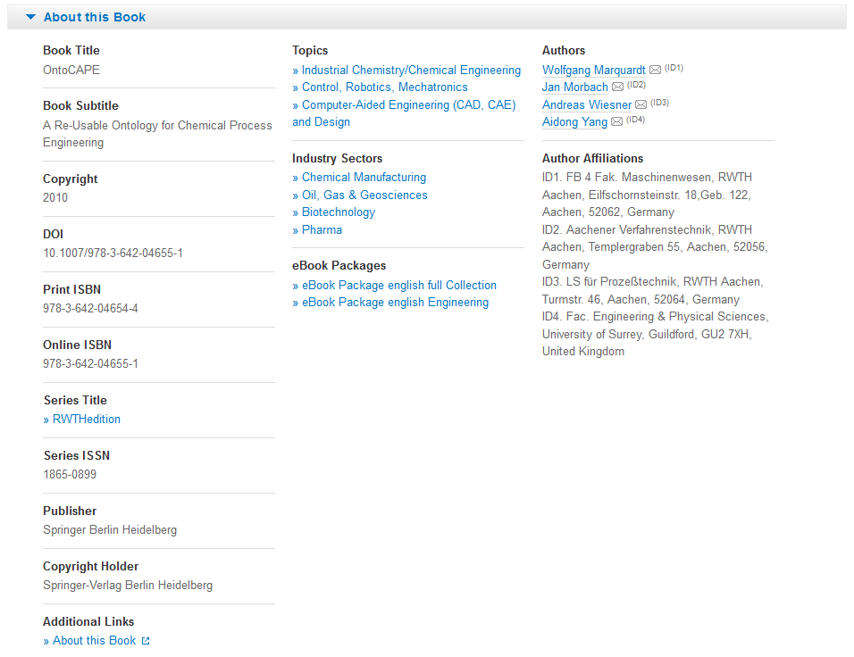
Book Homepage
About this book
On the bottom of a book overview page you will find detail information on the book:
Bibliographic information (1)
“Additional Links” to information and services offered on springer.com (2).
Topics Industry Sectors eBook Packages These links will lead to a search result list of related topics, industry sectors or ebook packages.
Author and Affiliations: To the right you find all author information and also their affiliations if available.
(1)
(3)
(4)
(2)

Slide 25
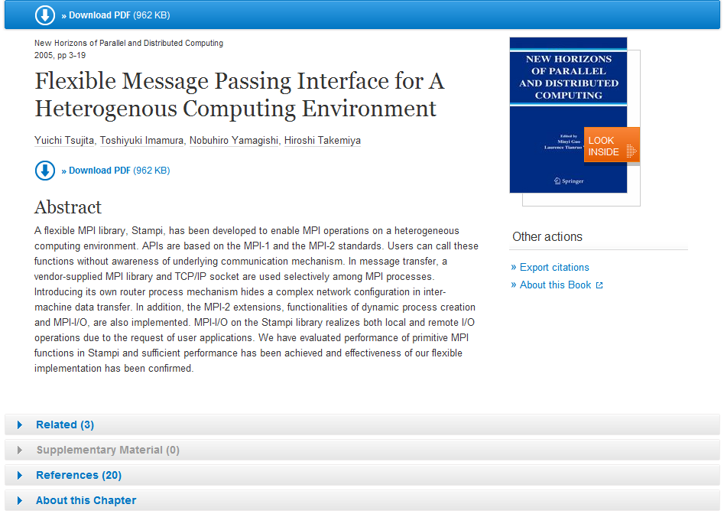
Book Chapter
(1)
Functionality Overview
Download PDF (1)
Look Inside (Preview) (2)
Abstract (3)
Export Citations (4)
Related (Content) (5)
Supplementary Material (6)
References (7)
About this Chapter (8)
Link to book homepage on springer.com (9)
The page structure is the same as for Journal Articles.
(2)
(1)
(3)
(4)
(9)
(5)
(6)
(7)
(8)

Slide 26
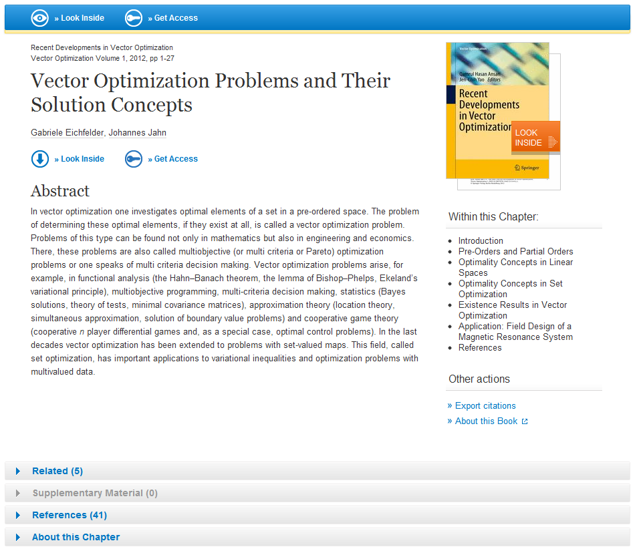
Book Chapter
No access to book chapter
If you have no access to the book chapter the page head is displayed in a different design:
There is a yellow underline below the blue bar to the top (1).
Instead of a download link you get a “Look Inside” link offered as well as a link to “Get fulltext Access to the chapter” (2).
“Within this Chapter” links below the cover are not active (3).
(1)
(2)
(3)

