Slide 1

New Springer Products in Hungary
Springer in Facts and Strategy
TIBERIUS IGNAT

Slide 2
Key facts
Leading global scientific publisher, providing researchers in academia, scientific institutions
and corporate R&D departments with quality content via innovative information products
and services
Trusted local-language publisher in Europe – especially in Germany and the Netherlands – primarily for physicians and professionals working in the automotive, transport and
healthcare sectors
Consolidated turnover in 2011: EUR 875 million; in 2010: EUR 866 million; in 2009:
EUR 859 million
Some 2,000 journals and more than 7,000 new book titles published every year, in 6 main publishing fields: science, technology, medicine, business, transport and architecture
Springer eBook Collection with more than 55,000 titles available on springerlink.com;
expected to be over 110,000 (including the Springer Book Archives) in 2013.
Largest open access portfolio worldwide, with over 300 open access journals
More than 7,000 employees in some 25 countries worldwide

Slide 3
Leading in scientific publishing markets
Scientific publishing by the Springer group
Around 2,000 journals and more than 7,000 new book titles annually, the vast majority of which are scientific Publishing partnerships with more than 500 scientific societies Growing presence in emerging markets SpringerLink One of the leading internet science portals, including more than 5.5 million documents, an eBook Collection with more than 55,000 titles, journal archives digitized back to the first issues in the 1800s and more than 26,000 Protocols and 215 Reference Works | Open access activities Largest Open Access (OA) publisher with more than 300 OA journals, including BioMed Central, the pioneering OA publisher Pharma / Healthcare Includes portfolio of highly-regarded Adis scientific journals and newsletters in pharmacology and pharmacotherapy German-language content Leading professional medicine publishers in Germany, including renowned products such as Ärzte Zeitung, e.Akademie and springermedizin.de Leading publishing brands in business and technology such as Springer Gabler and Springer Vieweg

Slide 4

SpringerLink usage: 2005 – 2011
Usage up 11% from 2010 to 2011
Full text downloads in millions
eBooks
eBooks: +13%
Journals
Journals: +10%

Slide 5







































Our publishing brands

Slide 6
Leading Publishers: Number of Books Published
Number of English-Language Titles Published in 2011
4,734
3,959
2,272
1,578
1,457
1,308
1,077
725
239
(Data from www.puballey.com and publisher websites; if a book is published simultaneously in hard- and paperback editions, only the hardback edition was included)

Slide 7
Leading Publishers: Number of Journals Titles
Number of English-Language Journals Published in 2012
2,191
2,056
1,734
1,517
626
304
275
253
(English-language academic/scholarly journals)

Slide 8
Market Positions by ISI Data
Top 10 rankings by JCR data ...
by number of titles by number of articles by number of cites
(JCR = ISI Journal Citation Reports 2011 Science Edition; English-language academic/scholarly journals published in 2012)

Slide 9
Leading book publishers by number of new titles 2011
4,734
3,959
2,272
1,578
1,457
1,308
1,077
725
239
(Data from www.puballey.com and publisher websites; if a book is published simultaneously in hard- and paperback editions, only the hardback edition was included)

Slide 10


Book Market Positions by Disciplines
Discipline | #1 Publisher | #2 Publisher | #3 Publisher
Clinical Medicine | Lippincott W&W | Elsevier Health | McGraw-Hill | #4/5
Biomedical & Life Sciences |  | Wiley-Blackwell | Elsevier
Earth & Environmental Science |  | CUP | Wiley-Blackwell
Chemistry & Materials Science | Wiley-Blackwell |  | Taylor & Francis
Physics & Astronomy |  | CUP | Wiley-Blackwell
Engineering | Wiley-Blackwell |  | Taylor & Francis
Computer Science (research-level) |  | IEEE | IGI Global
Mathematics & Statistics |  | Wiley-Blackwell | Taylor & Francis
Business & Economics | Taylor & Francis | Palgrave Macmillan | Edwin Elgar | #4/5
Social Sciences & Humanities | Taylor & Francis | OUP | Palgrave Macmillan | #8/10

Slide 11
Springer eBooks 2012
Springer eBook Collection | Number of titles
Subject Collections
Behavioral Science | 65
Biomedical and Life Science | 475
Business and Economics | 260
Chemistry and Materials Science | 225
Computer Science | 935
Earth and Environmental Science | 230
Engineering | 650
Humanities, Social Science & Law | 490
Mathematics and Statistics | 425
Medicine | 490
Physics and Astronomy | 320
Professional Computing and applied Computing | 160
Total | 4725
 | 4725

Slide 12
And, eBooks can be purchased in 5 annual Subject Collections (German)
Subject Collection | # titles 2011
Medizin | 145
Technik & Informatik | 245
Natur- und Basiswissenschaften incl. Mathematik | 130
Wirtschaftswissenschaften | 510
Geistes- und Sozialwissenschaften | 620
Total | 1650

Slide 13



eBook Collection
Springer’s eBook Collection includes the following content types:
  eBooks
    Textbooks, Monographs, Atlases, and more
  eReference Works
    Handbooks and Major Reference Works
  eBook Series
Organized into 13 + 5 Subject Collections
Annual subject specific packages, available per package (Subject Collection)
Prices tailored to size of institution (research intensity)
~ Available on
SpringerLink

Slide 14
Springer eBook Business Model
13 Subject Specific Collections
Ownership model/Perpetual access to acquired content
Unlimited Use
100% DRM Free
Integrated Access on SpringerLINK
Lower title cost than list price
Working towards simultaneous release
Notes:
14

Slide 15
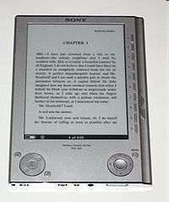
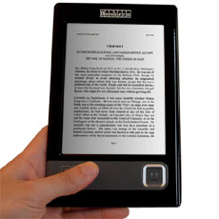
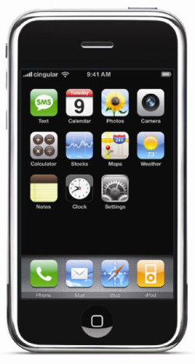
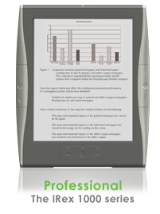
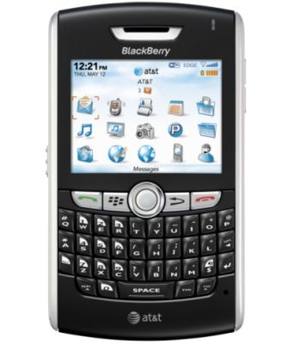

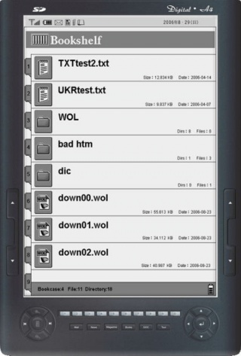
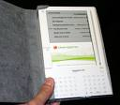
eReaders – the future of reading?

Slide 16
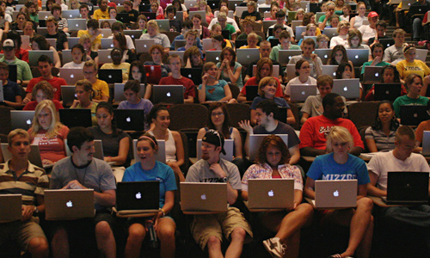

Slide 17

What is Springer’s “MyCopy”?
SpringerLink-users with access to Springer’s eBooks can order
print book from that collection
only from SpringerLink
For only 24.95 EUR / USD (including shipping)
No extra charge and no extra work for the library

Slide 18
What is Springer’s “MyCopy”?
Over 25.000 eBooks will be offered as MyCopy (and growing)
  POD-suitable eBooks (limited page number)
  copyright year > 2005 (but book archives coming soon)
  English language titles
Soft cover is 4-color and inner work is black and white
Available in most of Europe, USA and Canada

Slide 19

Branding MyCopy Books
MyCopy visual
on book spine
MyCopy wordmark
and SpringerLink logo on front cover

Slide 20
Springer in Facts and Strategy

Slide 21
Article Output 2000-10 by region
Country/Region | Articles 2000 | Articles 2010 | CAGR | Article Share 2000 | Article Share 2010
Northern America | 345,434 | 514,647 | 4.1% | 35.7% | 24.8%
Latin America | 21,974 | 80,895 | 13.9% | 2.3% | 3.9%
Western Europe | 318,218 | 553,498 | 5.7% | 32.9% | 26.6%
Eastern Europe | 66,961 | 124,250 | 6.4% | 6.9% | 6.0%
Asia | 158,280 | 619,970 | 14.6% | 16.3% | 29.8%
Pacific | 25,379 | 62,378 | 9.4% | 2.6% | 3.0%
Middle East | 22,406 | 90,310 | 15.0% | 2.3% | 4.3%
Northern Africa | 1,646 | 9,410 | 19.0% | 0.2% | 0.5%
Central Africa | 2,084 | 7,401 | 13.5% | 0.2% | 0.4%
Southern Africa | 6,107 | 15,230 | 9.6% | 0.6% | 0.7%
Total | 968,489 | 2,077,989 | 7.9% | 100% | 100%
(Source : SCImago. (2007). SJR — SCImago Journal & Country Rank. Retrieved June 11, 2012, from http://www.scimagojr.com)

Slide 22
Eastern Europe: Ranking by research articles
Rank | Country | Articles 2000 | Articles 2010 | CAGR | Article Share 2000 | Article Share 2010
1 | Russian Federation | 30,147 | 35,446 | 1.6% | 2.75% | 1.57%
2 | Poland | 12,948 | 26,057 | 7.2% | 1.18% | 1.16%
3 | Czech Republic | 5,483 | 13,790 | 9.7% | 0.50% | 0.61%
4 | Ukraine | 5,328 | 6,590 | 2.2% | 0.49% | 0.29%
5 | Hungary | 5,019 | 7,542 | 4.2% | 0.46% | 0.33%
6 | Romania | 2,523 | 10,897 | 15.8% | 0.23% | 0.48%
7 | Slovakia | 2,313 | 4,195 | 6.1% | 0.21% | 0.19%
8 | Slovenia | 1,956 | 4,104 | 7.7% | 0.18% | 0.18%
9 | Bulgaria | 1,947 | 3,293 | 5.4% | 0.18% | 0.15%
10 | Croatia | 1,859 | 4,988 | 10.4% | 0.17% | 0.22%
11 | Belarus | 1,247 | 1,423 | 1.3% | 0.11% | 0.06%
12 | Lithuania | 614 | 2437 | 14.8% | 0.06% | 0.11%
13 | Estonia | 596 | 1849 | 12.0% | 0.05% | 0.08%
14 | Armenia | 415 | 696 | 5.3% | 0.04% | 0.03%
15 | Latvia | 350 | 797 | 8.6% | 0.03% | 0.04%
16 | Georgia | 311 | 713 | 8.6% | 0.03% | 0.03%
17 | Moldova | 235 | 283 | 1.9% | 0.02% | 0.01%
18 | Azerbaijan | 184 | 717 | 14.6% | 0.02% | 0.03%
19 | Macedonia | 159 | 452 | 11.0% | 0.01% | 0.02%
20 | Bosnia and Herzegovina | 50 | 636 | 29.0% | 0.00% | 0.03%
21 | Serbia | 43 | 4,742 | 60.1% | 0.00% | 0.21%
22 | Albania | 35 | 192 | 18.6% | 0.00% | 0.01%
(Source: SCImago. (2007). SJR — SCImago Journal & Country Rank, Retrieved March 15th, 2012, from http://www.scimagojr.com)

Slide 23
Research output by disciplines
(Source: SCImago. (2007). SJR — SCImago Journal & Country Rank, Retrieved March 15th, 2012, from http://www.scimagojr.com)

Slide 24
Trends in STM Publishing
Journals: from print (<1997) to print-and-online (1997-2005) to online-only (>2005)
Digitization of Books: Now approx. 15-20%
Electronic editorial office: online article submission and peer-review
‘Google-ization’
Open Access

Slide 25
The Golden Rules of STM Publishing in Today’s Environment
1. Your content has to be online
All new articles (150,000/yr)
Backfiles
(2.4 million)
eBooks project (15,000 books)
All new books (5,500/yr)
2. Your content has to be “findable”
SEO
A&I services
Library portals
Book search programs
eRetail
Social Media
Push marketing

Slide 26






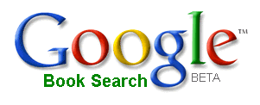








Findability and visibility of content are key
How Springer leverages business opportunities
Search Engine
Optimization
Abstract & Indexing
Services
Book search programs
eRetail
Social Media

Slide 27

Scientists spend almost 12 hours per week on information tasks
11.7
Median hours per week
Source: Outsell Information markets & Users Database; N=2,070 Faculty, Graduate Students and R&D/Science professionals

Slide 28
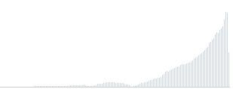
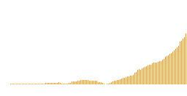

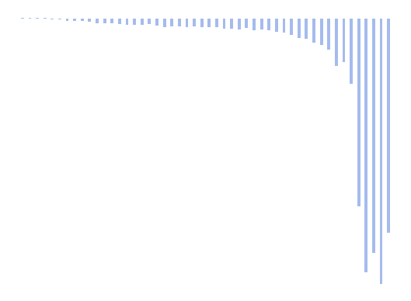
2013: Digitize everything
146,000 articles/yr
1996
2004
“Digitize all journals going forward!”
“Digitize all journals going backward!”
1842
Springer-Verlag founded
Journals
1860
1870
1880
1890
1900
1910
1920
1930
1940
1950
1960
1970
1980
1990
2000
2010
Books
2006
2009
“Digitize most books going forward!”
“Digitize all books going forward and a lot of books going backward!”
Brian Bishop, Sept 2009
Notes:
Journal articles:
From 1996 to 2009 = 1.6 million published articles
From 1842 to 1996 = 2 million published articles
Online Journal Archive = 38 million EUR revenues

Slide 29
Springer Book and Journal Archives
More than 65.000 STM eBooks, dating back to 1840s
More than 1.000 Journal titles and 2 million articles, dated back to 1854
No DRM
Available starting in mid-2012
Integrated into SpringerLink
Primarily PDF only, with selected titles in XML
Benefits for Librarians
Complete collections and expand holdings
Reduce the physical space needed to house collections
Decrease staff time needed to manage physical collections
Ensure access for patrons to works previously unavailable electronically or out of print
Elliminate spoilage issues and reduce need to scan
Expand patron access to MyCopy
Free (OCLC) MARC Records

Slide 30

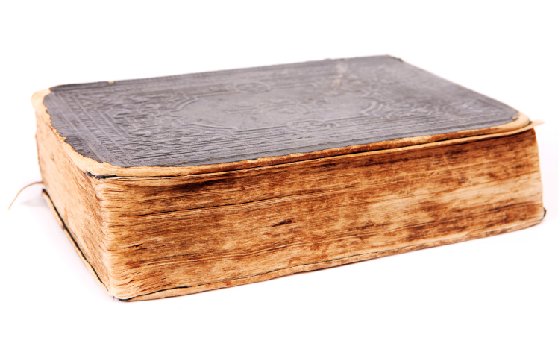
SCANNING
Black-and-white 600 dpi 1-bit monochrome (bitonal)
300 dpi grayscale (8-bit) and color (24-bit)
OCR used (also for German Fractura)
Pages cleaned up before scanning
Superimposing for images
  1st scanning: only text
  2nd scanning: color images
  Images are then mounted into full-text PDFs
Non-destructive scanning for rare and fragile books
Note: Scanning quality is only as good as original print book

Slide 31

Metadata
Bibliographic information, TOC and References in XML
Copyright holder/year from book copyright page
ISBN and DOI are added
10-digit-ISBN’s converted into 13-digit-ISBNs
(Capturing metadata)

Slide 32



Output formats
Soft-cover POD
eBook: full-text searchable
MyCopy
Full-text XML (selected titles)

Slide 33


Quality Assurance
Quality check
Metadata quality
Full text content (As of 03/2012)
Multiple iterations at SPi, Crest and Springer

Slide 34

Highlights
Max Planck
Rudolf Diesel
Niels Bohr
Werner Siemens
Andrey Kolmogorov
Otto Hahn
Lise Meitner
Karl Scheel
Albert Einstein
Max Delbrück
… and many more…

Slide 35
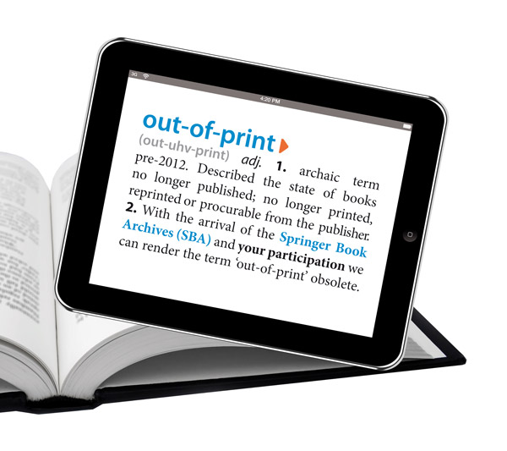

Slide 36
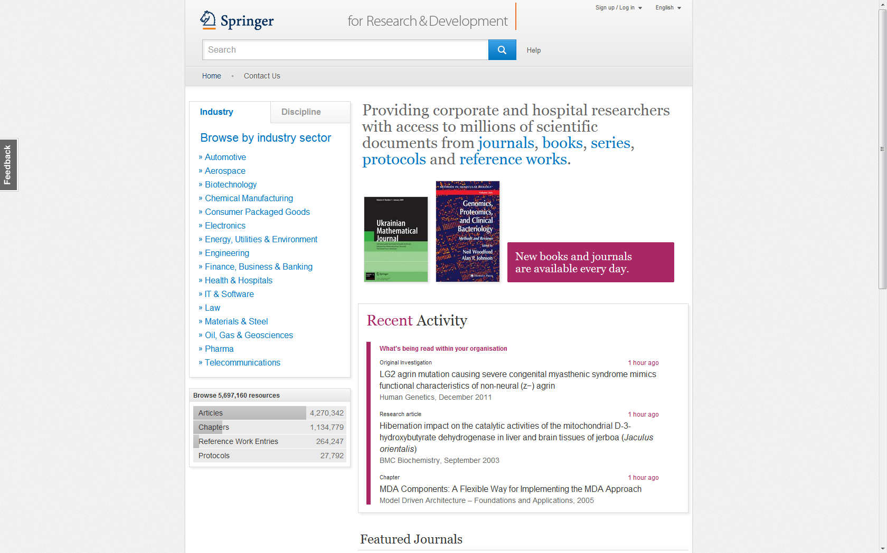

Slide 37
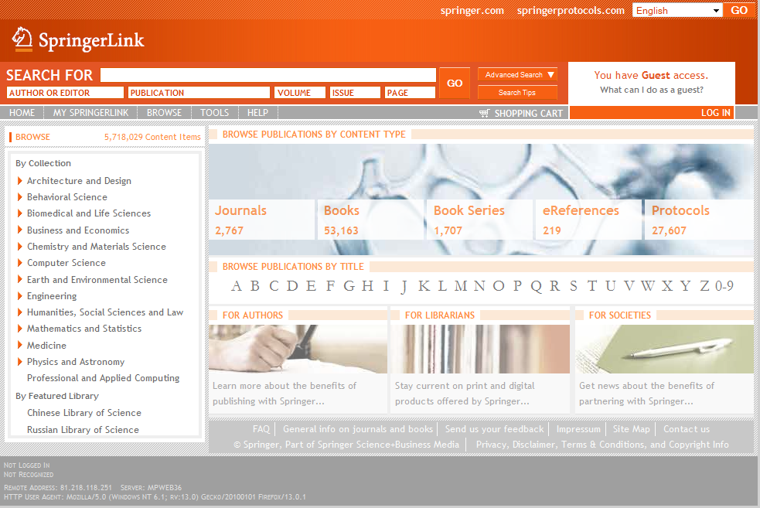
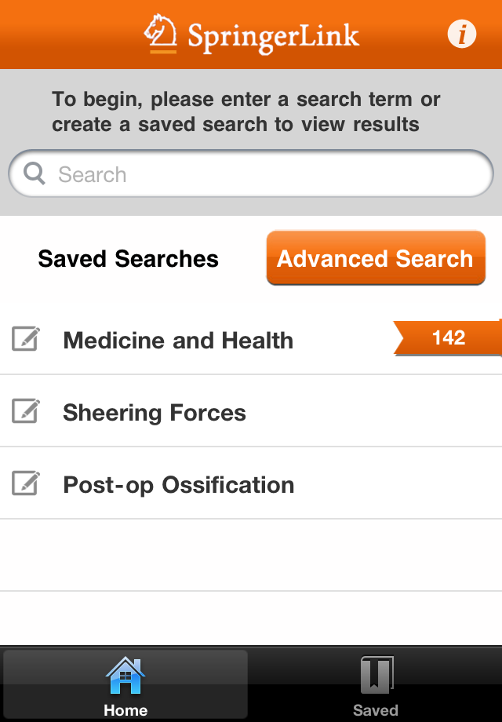

SpringerLink app
Released October 18th, 2011
Free to download
Provides search and discovery of all Springer and BMC content
Full text access through SpringerLink for authentication and reporting

Slide 38

And….in development….
Springer eBooks in ePub format on SpringerLink

Slide 39
What is SpringerMaterials?
  SpringerMaterials is a new one-stop web platform. It contains a systematic & comprehensive database of selected and critically assessed physico chemical data.
  Based on Landolt-Börnstein, the unique and top-quality data collection in all areas of physical sciences and engineering.
It consists of 70,000 online documents, includes more than 120,000 figures, more than 1 million literature references and over 65,000 keywords.
SpringerMaterials replaces the previous Landolt-Börnstein product as of January 2010
Landolt-Börnstein
SpringerMaterials
Siteguide of the Platform
Comparable Products
Additional Information

Slide 40
Figures
  Landolt-Börnstein is a data collection equivalent to
  >190,000 pages in 70,000 online documents (extracted from 380 printed volumes)
  >120,000 figures
  >1 Mio literature references
  65,000 keywords
  >150,000 chemical substances
  >72,000 element systems
  >530,000 substance-property pairs
  nearly 1,5 Mio synonyms
Landolt-Börnstein
SpringerMaterials
Siteguide of the Platform
Comparable Products
Additional Information

Slide 41
Who uses SpringerMaterials and Why?
  Academic Institutions: Researchers
  Corporations: Employees in R&D Departments
  Find the expert knowledge needed to reliably design new materials
  Find out which material offers the most suitable parameters for the research project
  Evaluate and verify experimental data after concrete measurements and refer to known material parameters
  Save time by not having to scan and evaluate existing literature on the research topic
Landolt-Börnstein
SpringerMaterials
Siteguide of the Platform
Comparable Products
Additional Information

Slide 42
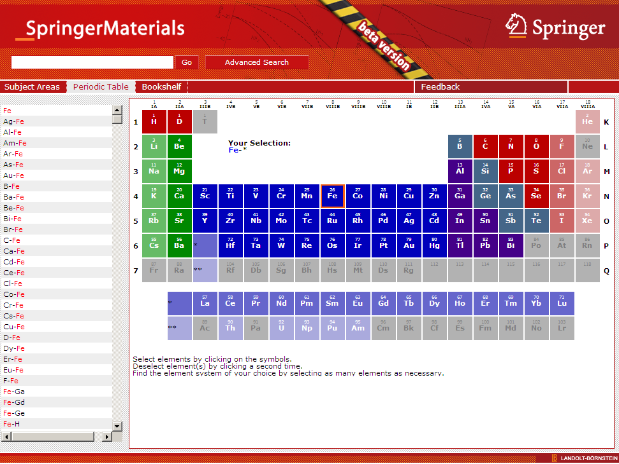
Search via Periodic Table – Search Result Page
Select chemical
elements
Available content
shown
Landolt-Börnstein
SpringerMaterials
Siteguide of the Platform
Comparable Products
Additional Information

Slide 43





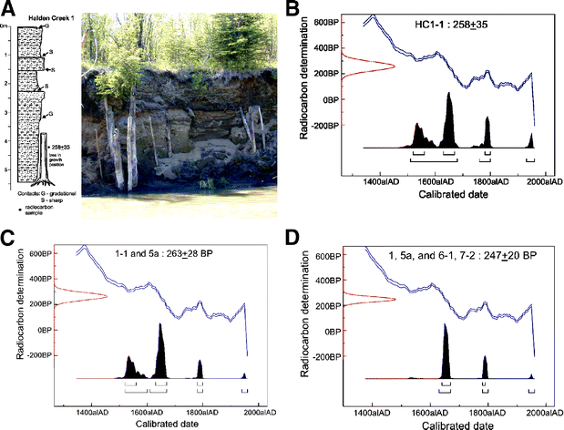



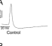



What is SpringerImages?
A database of over 2 million images and associated pieces of full-text from Springer XML content, and third-party scientific image sources Images
  Images include: drawings, photos, tables, charts, etc.
Springer Journals
biology image library
Open Access
Springer Books
Notes:
Biological Image Library (BioMed Central, biologyimagelibrary.com): Available after the launch.
Description: The library is a collection of images, illustrations, movies and animations that are useful for research and education. It is also a new, easy way to share your work with others without losing any rights to it or limiting how you use it in the future.
Images.MD (Current Medicine Group, images.md)
Description: images.MD compiles over 70,000 high-quality images spanning all of internal medicine, all derived from Current Medicine Group LLC’s renowned series of illustrated atlases. Each image is accompanied by detailed and informative text written by over 2,000 contributing experts.

Slide 44
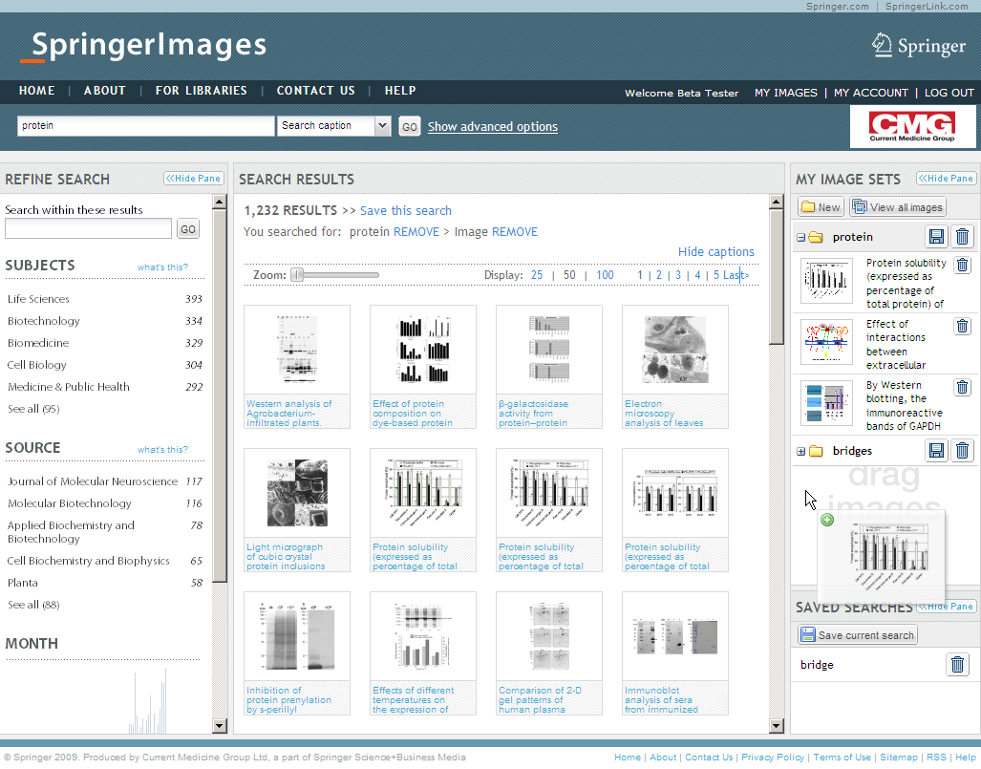
Search Results Page
Refine your search results easily by: text, subject, source, publication date or image type
Zoom in to have a closer look at the results. Click on one of the thumbnails to go to image details page
Drag and drop your favourite images to one of your image sets (log in required)
Save your search (login required)

Slide 45
Key Facts About SpringerImages - database
2 million+ scientific, technical and medical images
  Images: photos, graphs, histograms, figures and tables
Constantly growing database
Variety of sources: SpringerLink, SpringerProtocols, images.MD, and more
Peer-reviewed, trusted sources
Unlimited concurrent users
Availability: Entire collection or Medical and Life Sciences
Permission to use images for personal, non-commercial use
SpringerImages has its own, independent platform.
At the moment no integration with SpringerLink – only connection is linking from an image to original full-text source on SpringerLink

Slide 46
All science image database – strong in medicine and ls
Images* | Subject Collection
181,000 | Biomedicine
312,000 | Life Sciences
481,000 | Medicine & Public Health
2,000 | Pharmacy
240,000 | Chemistry
29,000 | Computer Science
16,000 | Economics/Management Science
6,000 | Education
83,000 | Engineering
34,000 | Environment
3,000 | Geography
100,000 | Geosciences
15,000 | Humanities/Art
18,000 | Material Science
5,000 | Mathematics
62,000 | Physics
10,000 | Psychology
10,000 | Social Sciences
Notes:
* Per 1 July 2009

Slide 47
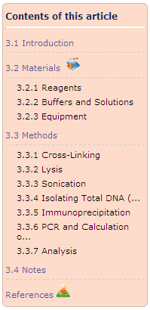
What are protocols?
Step-by-step instructions, in a standardized format,
that help researchers conduct experiments
Predefined written procedural methods in the design and implementation of experiments including:
  Bias
  Safety
  Equipment
  Statistical methods
  Reporting
  Troubleshooting
Used primarily in the life sciences

Slide 48
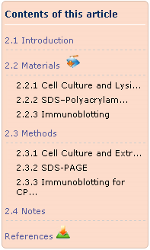
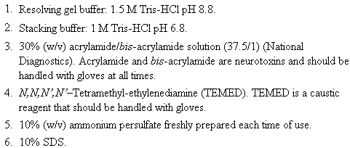
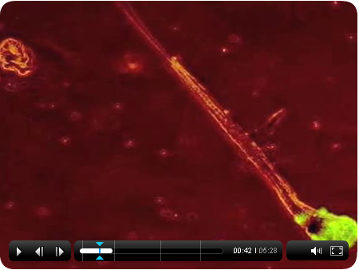
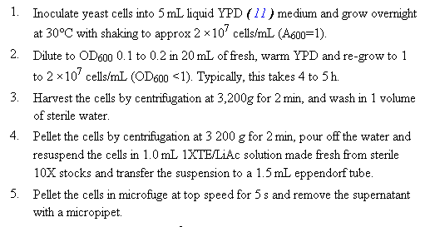
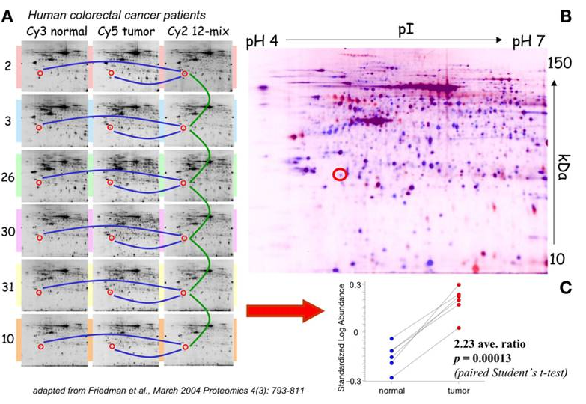

What makes a good protocol?
Complete and thorough instructions
Detailed materials list
Clearly organized
Supporting images/tables
Video Protocols
Trustworthy source
Notes:
Video Protocols are supplementary to some originally published protocols. Either the entire protocol or more complex sections of the published protocol is reproduced in video format.

Slide 49
Researchers use protocols to:
Solve biological problems on a molecular level
Identify, understand, manipulate, and explain biological processes, functions, structure, and activity of molecular cell components
Target cellular processes involved in disease (useful in developing early diagnosis and targeted treatments)
Discover new approaches to treating disease
Develop new drugs and lower the cost of drug development

Slide 50
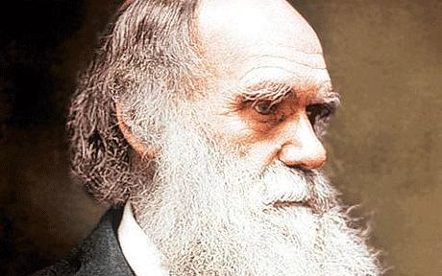
“It is not the strongest of the species that survive, nor the most intelligent, but rather the one most responsive to change”
Charles Darwin

Slide 51

Summary
All on SpringerLink
Over 8.000 new titles until 2015
88.000 + titles
2.684 Journals
30.168 Protocols
1.623 Book Series
234 eReferences
Databases are here
-SpringerMaterials
-SpringerImages
SpringerProtocols
SpringerReferences
SpringerBook Archives
Available on
SpringerLink

Slide 52

Thank You - Questions?
Tiberius Ignat
Phone (D) : +49 1515 1646 553
Phone (CH): +41 793 949 475
tiberius@scientificknowledgeservices.com
Szántó Péter
Phone: +36 20 322 4105
szanto.peter1@upcmail.hu

