Slide 1
Academic Libraries:
A Culture of Assessment and Selection
Tiberius Ignat
Scientific Knowledge Services
Notes:
Rapid changes in technology and associated shifts in research and scholarly communications are profoundly changing the role of libraries in the 21st century. The emergence of e-research - for example - is bringing new ways of doing science across the globe, compelling libraries to adopt new services. Exemples: assisting for the development of research data management plans, hosting collaborative virtual research environments, managing institutional repositories, and disseminating research outputs through paid publications or open access solutions.
These novel services require a new perspective on how libraries are ASSESSING and SELECTING activities, publications, people, processes and managerial decisions.

Slide 2
Understandings (1)
What are libraries for?
What is a modern librarian dealing with?
  books, magazines, newspapers, audio recordings (both musical and spoken-word), video recordings, maps, manuscripts, photographs and other graphic material, bibliographic databases, web searching, and digital resources. A librarian may provide other information services, including computer provision and training, coordination of public programs, basic literacy education, assistive equipment for people with disabilities, and help with finding and using community resources
Roles and responsibilities
  Archivists ¦ Collections development librarians ¦ Electronic resources librarians ¦ Instruction librarians ¦ Media specialists ¦ Outreach librarians ¦ Public service librarians ¦ Children's librarians ¦ Reference or research librarians ¦ Systems librarians ¦ Technical service librarians ¦ Young (YA) adult librarians
Notes:
Libraries as history: the importance of libraries beyond their texts. David Pearson (faculty member in the programs in Language and Literacy and Human Development at the Graduate School of Education at the University of California, Berkeley; he served as Dean from 2001-2010):
What are libraries for? Libraries were storehouses and quarries of knowledge, held in books. Human endeavour of many kinds, including education, research, invention, business and leisure, has always depended to some extent on access to information, or on what other people have known or said, and for many centuries books have been the containers for holding and transmitting these things.
Books were created to be communication devices for texts, and libraries existed to store, organise and make them accessible in large quantities.
The value of libraries has often been measured in terms of the size of their stock; more books means a greater reservoir, more comprehensiveness of coverage. There have been other sources of information but when looking for authoritative, cumulative and trustworthy places to find it and look after it, civilisation has turned to libraries.
But now the world is changing, in ways that are familiar to us all. Developments in information technology, coupled with the advent of the Internet, are transforming not only the ways in which libraries work, but also those underlying philosophies. Increasingly, the kind of content which books have provided is available over the web, either in born-digital formats or via digitised versions of printed material.
Traditionally, a librarian is associated with collections of books, as demonstrated by the etymology of the word "librarian" (from the Latin liber, 'book'). The role of a librarian is continuously evolving to meet social and technological needs. However, a modern librarian may deal with information in many formats, including books, magazines, newspapers, audio recordings (both musical and spoken-word), video recordings, maps, manuscripts, photographs and other graphic material, bibliographic databases, web searching, and digital resources. A librarian may provide other information services, including computer provision and training, coordination of public programs, basic literacy education, assistive equipment for people with disabilities, and help with finding and using community resources.
Roles and responsibilities
- Positions and duties
Most librarians spend their time working in one of the following areas of a library: (AREAS READ ONLY – NO FULL DESCRIPTIONS)
Archivists can be specialized librarians who deal with archival materials, such as manuscripts, documents and records, though this varies from country to country, and there are other routes to the archival profession.
Collections development librarians monitor the selection of books and electronic resources. Large libraries often use approval plans, which involve the librarian for a specific subject creating a profile that allows publishers to send relevant books to the library without any additional vetting. Librarians can then see those books when they arrive and decide if they will become part of the collection or not. All collections librarians also have a certain amount of funding to allow them to purchase books and materials that don't arrive via approval.
Electronic resources librarians manage the databases that libraries license from third-party vendors. School librarians work in school libraries and perform duties as teachers, information technology specialists, and advocates for literacy.
Instruction librarians teach information literacy skills in face-to-face classes and/or through the creation of online learning objects. They instruct library users on how to find, evaluate and use information effectively. They are most common in academic libraries.
Media specialists teach students to find and analyze information, purchase books and other resources for the school library, supervise library assistants, and are responsible for all aspects of running the library/media center. Both library media teachers (LMTs) and young adult (YA) public librarians order books and other materials that will interest their young adult patrons. They also must help YAs find relevant and authoritative Internet resources. Helping this age group to become lifelong learners and readers is a main objective of professionals in this library specialty.
Outreach librarians are charged with providing library and information services for underrepresented groups, such as people with disabilities, low income neighborhoods, home bound adults and seniors, incarcerated and ex-offenders, and homeless and rural communities. In academic libraries, outreach librarians might focus on high school students, transfer students, first-generation college students, and minorities.
Public service librarians work with the public, frequently at the reference desk of lending libraries. Some specialize in serving adults or children.
Children's librarians provide appropriate material for children at all age levels, include pre-readers, conduct specialized programs and work with the children (and often their parents) to help foster interest and competence in the young reader. (In larger libraries, some specialize in teen services, periodicals, or other special collections.)
Reference or research librarians help people doing research to find the information they need, through a structured conversation called a reference interview. The help may take the form of research on a specific question, providing direction on the use of databases and other electronic information resources; obtaining specialized materials from other sources; or providing access to and care of delicate or expensive materials. These services are sometimes provided by other library staff that have been given a certain amount of special training.
Systems librarians develop, troubleshoot and maintain library systems, including the library catalog and related systems.
Technical service librarians work "behind the scenes" ordering library materials and database subscriptions, computers and other equipment, and supervise the cataloging and physical processing of new materials.
A young adult or YA librarian serves patrons who are between 12 and 18 years old. Young adults are those patrons that look to library services to give them direction and guidance toward recreation, education, and emancipation. A young adult librarian could work in several different institutions; one might be a school library/media teacher, a member of a public library team, or a librarian in a penal institution. Licensing for library/media teacher includes a Bachelor or Master of Arts in Teaching and additional higher-level course work in library science. YA librarians who work in public libraries usually have a Master's degree in Library and/or Information Science (MLIS), relevant work experience, or a related credential.
Additional responsibilities
Experienced librarians may take administrative positions such as library or information center director. Similar to the management of any other organization, they are concerned with the long-term planning of the library, and its relationship with its parent organization (the city or county for a public library, the college/university for an academic library, or the organization served by a special library). In smaller or specialized libraries, librarians typically perform a wide range of the different duties.
Representative examples of librarian responsibilities:
Researching topics of interest for their constituencies.
Referring patrons to other community organizations and government offices.
Suggesting appropriate books ("readers' advisory") for children of different reading levels, and recommending novels for recreational reading.
Facilitating and promoting reading clubs.
Developing programs for library users of all ages and backgrounds.
Managing access to electronic information resources.
Building collections to respond to changing community needs or demands
Creating pathfinders
Writing grants to gain funding for expanded program or collections
Digitizing collections for online access
Answering incoming reference questions via telephone, postal mail, email, fax, and chat
Making and enforcing computer appointments on the public access Internet computers

Slide 3
Understandings (2)
Assessment: using the ability to make good decisions about what should be done (based on a Merriam Webster definition).
Selection: the result of a judicious or restrictive choice (based on a Merriam Webster definition).
Notes:
Additional responsibilities
Experienced librarians may take administrative positions such as library or information center director. Similar to the management of any other organization, they are concerned with the long-term planning of the library, and its relationship with its parent organization (the city or county for a public library, the college/university for an academic library, or the organization served by a special library). In smaller or specialized libraries, librarians typically perform a wide range of the different duties.
Representative examples of librarian responsibilities:
Researching topics of interest for their constituencies.
Referring patrons to other community organizations and government offices.
Suggesting appropriate books ("readers' advisory") for children of different reading levels, and recommending novels for recreational reading.
Facilitating and promoting reading clubs.
Developing programs for library users of all ages and backgrounds.
Managing access to electronic information resources.
Building collections to respond to changing community needs or demands
Creating pathfinders
Writing grants to gain funding for expanded program or collections
Digitizing collections for online access
Answering incoming reference questions via telephone, postal mail, email, fax, and chat
Making and enforcing computer appointments on the public access Internet computers

Slide 4
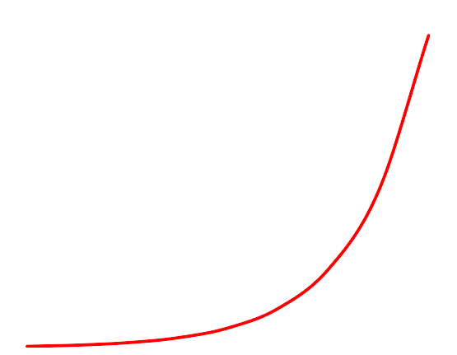
Scholarly Articles ^{Growth}
The future of the science publishing ego-system
Jan Velterop – LIBER 2013

Slide 5
Last 12 months
989195 new abstracts in PubMed
525,600 minutes in a year
i.e. a new article every half minute
The future of the science publishing ego-system
Jan Velterop – LIBER 2013

Slide 6

The future of the science publishing ego-system
Jan Velterop – LIBER 2013

Slide 7
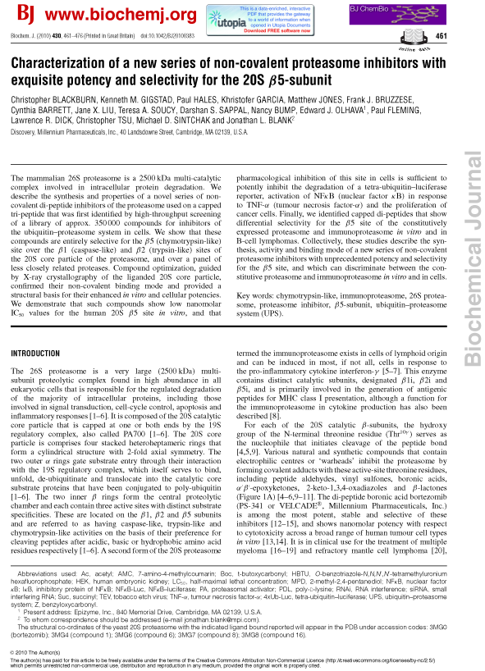
The future of the science publishing ego-system
Jan Velterop – LIBER 2013

Slide 8

The future of the science publishing ego-system
Jan Velterop – LIBER 2013

Slide 9
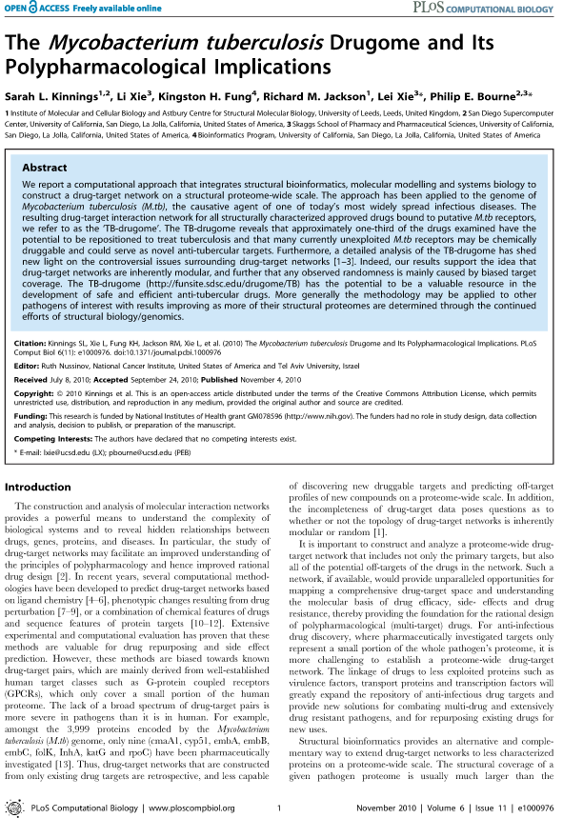
The future of the science publishing ego-system
Jan Velterop – LIBER 2013

Slide 10
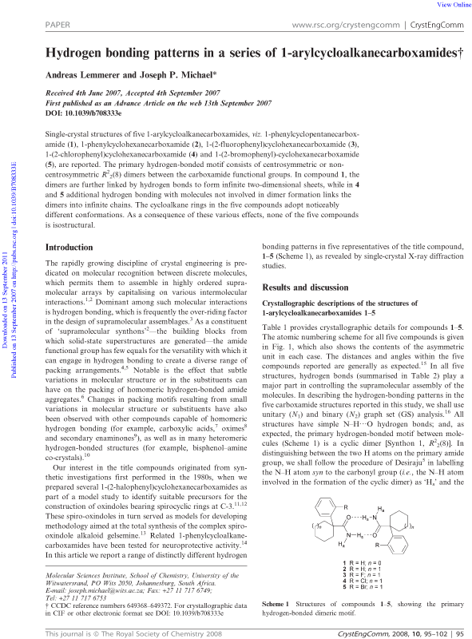
The future of the science publishing ego-system
Jan Velterop – LIBER 2013

Slide 11
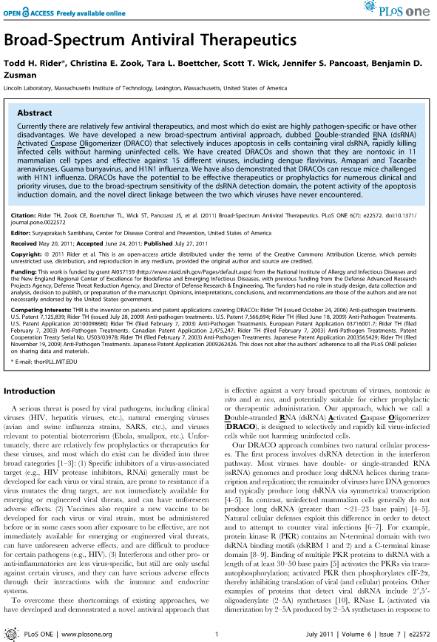
The future of the science publishing ego-system
Jan Velterop – LIBER 2013

Slide 12
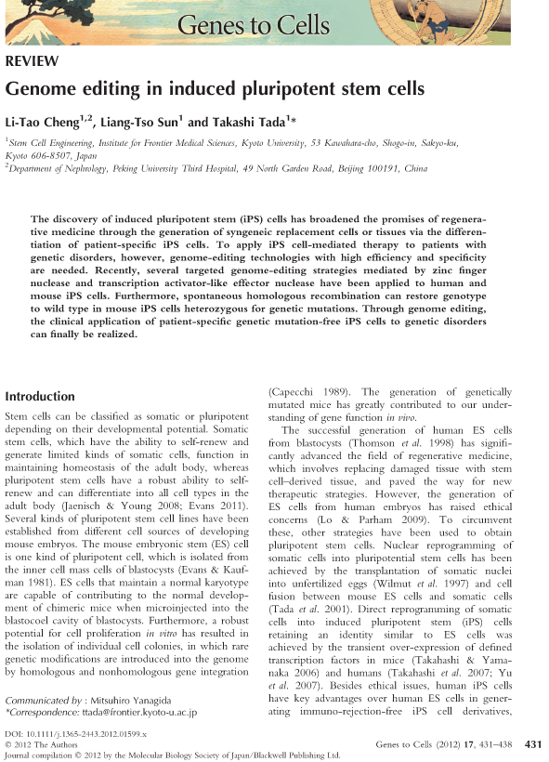
The future of the science publishing ego-system
Jan Velterop – LIBER 2013

Slide 13
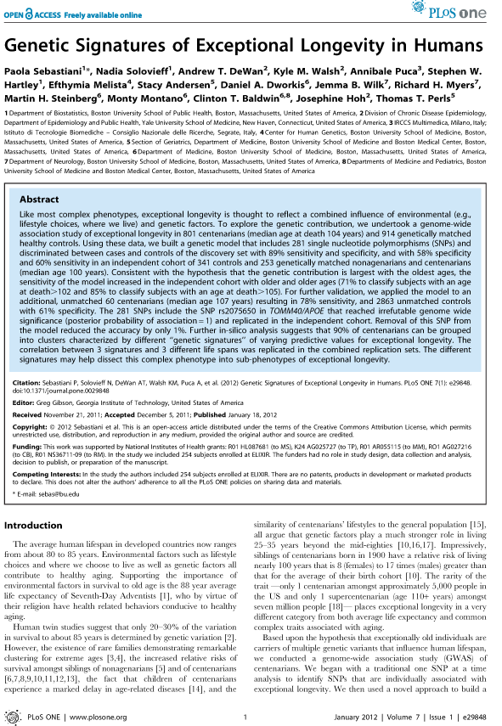
The future of the science publishing ego-system
Jan Velterop – LIBER 2013

Slide 14
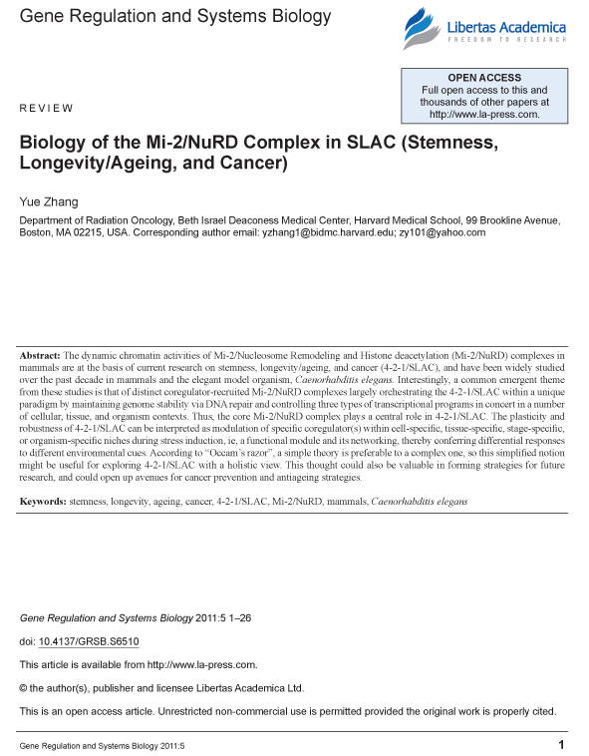
The future of the science publishing ego-system
Jan Velterop – LIBER 2013

Slide 15
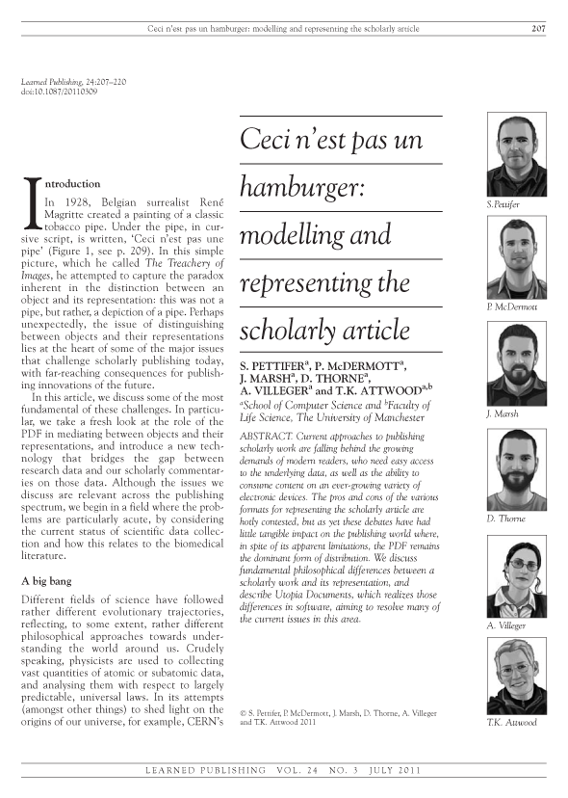
The future of the science publishing ego-system
Jan Velterop – LIBER 2013

Slide 16
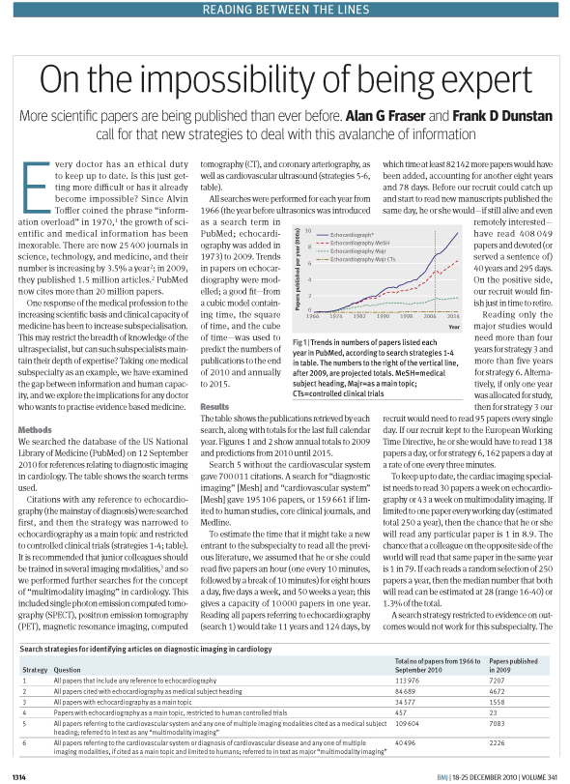
The future of the science publishing ego-system
Jan Velterop – LIBER 2013

Slide 17
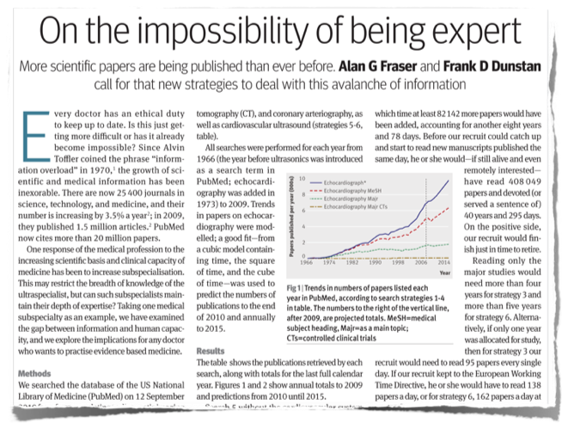
The future of the science publishing ego-system
Jan Velterop – LIBER 2013

Slide 18
Library: A Culture of Assessment
Assessment is the norm
Doing it for the right reasons
Customer-service focused
Culture of learning, curiosity
Decisions based on data
New initiatives tied to performance measures
Changes based on what is learned
Building and Sustaining a Culture of Assessment at Your Library
by Meredith Farkas on Jun 05, 2012

Slide 19
What to assess?
Publications, databases, trials
Software, hardware
Research outputs
Reports (ex. Usage statistics)
Funding opportunities
Innovate communications (IR, new media)
New technologies
Production of knowledge
Transfer of knowledge

Slide 20
Necessary Assessment Culture Traits
Trusting
Positive / Optimistic
Adaptive
Tolerance to unknown
Open communications
Both librarians and users feel safe experimenting
Customer services focus
Learning Culture
Building and Sustaining a Culture of Assessment at Your Library
by Meredith Farkas on Jun 05, 2012
Notes:
What are the distingushing qualities for a Culture of Assessment?
Trusting: Makes Assessment more solid
Positive / Optimistc: It is not recommended to assess while pesimist. Always see the full part of the glass
Adaptive: Assessment and its possible lead to a change will not be useful without an ADAPTIVE SPIRIT
Tolerance to Unknown: Assessement should leave an open door to what we don’t know.
Open Communications: without it, people will not trust the result of assessment
Safe experimenting: we should accept risks, losses, news, gains. We cannot assess without being explorers
Customer Service focus: always with our customers (readers, professors, researchers, students) in mind
Learning Culture: do not repreat what was wrong. Learn from what you gained and what you already assessed.

Slide 21
Library: A Culture of Selection
Selection is a must
Doing it correctly
Customer-service focused
Envision trends, think in long terms, adapt to medium terms, react to short terms and deadlines
Authoritive decisions based on data
Working with funding opportunities and budgets
Notes:
Selection is a must: Swift from Just in Case to Just in Time! Remember, Assessment is the norm!
Doing it correctly: Transparent process, no drama, no sympathies, no nostalgies, no hard feelings,... remember, Assessment – doing it for right reasons!
Customer-service focused: same as in Assessment
Envision trends, ...: This is the essence of Selection. Good selections are based on good projections and action plans
Authoritive decisions based on data: Who is doing the selection. What authority she/he has? Based on which date she/he acts?
Working with funding opportunities and budgets: Librarians should learn to apply for grants, new funding programs, plan and execute budgets

Slide 22
What to select?
Collections, publications, databases
Vendors, products, services
Hardware and software solutions
Research projects to join in
Reporting tools
Funding proogrammes
Marketing and communication tools
Implementation of technologies
Notes:
Without being limited to, here is a list of what libraries could to select.

Slide 23
The selection of innovation in libraries
Empowering innovations
  These transform complicated and costly services and products (inc. publications) available to a few into simpler, cheaper solutions available to the many. This is the case of e-books, journal collections or content production solutions
Sustaining innovations
  These replace old services and products (incl. publications) with new ones. This is the case of discovery solutions, electronic catalogues, etc.
Efficiency innovations
  These reduce the cost of sustaining the existing services, collections, activities, subscriptions, etc.
Clayton M. Christensen,
business professor at Harvard
LIBRARIES typically transition through these three types of innovations. The dials on these three innovations are sensitive. But when they are set correctly, the library is a magnificent machine
Notes:
Executives and investors might finance three types of innovations with their capital. I’ll call the first type “empowering” innovations
The Ford Model T was an empowering innovation, as was the Sony transistor radio. A more recent example is cloud computing. It transformed information technology that was previously accessible only to big companies into something that even small companies could afford. Empowering innovations create jobs, because they require more and more people who can build, distribute, sell and service these products. Empowering investments also use capital — to expand capacity and to finance operations.
The second type are “sustaining” innovations. For example, iPhone is a marvelous product. But it’s not as if every time Apple sells an iPhone, the same customer also buys a Nokia. There is a zero-sum aspect to sustaining innovations: They replace yesterday’s products with today’s products. They keep our library environment vibrant — and they account for the most innovation. But they have a neutral effect in bringing libraries in a leading role in the academic universe.
The third type are “efficiency” innovations. Such innovations almost always reduce the net number of jobs, because they streamline processes.
Efficiency innovations also emancipate capital
LIBRARIES typically transition through these three types of innovations. The dials on these three innovations are sensitive. But when they are set correctly, the library is a magnificent machine.

Slide 24
Conclusions (1)
Library Trials are essential rotating wheels in Assessment and Selections mechanisms;
  Library’s perspective
  Users’ perspective
  Publisher’s perspective
New assessment and selection techniques (such as price per impact factor or assessment of HSS literature) play a vital role in modern libraries;
The management of trials makes the difference between good and bad decisions.

Slide 25
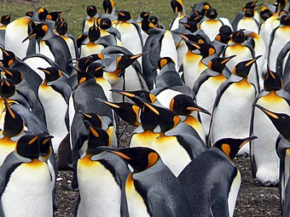

How are we filtering or choosing anyway?
25

Slide 26
Lens,
Focus

Slide 27


Slide 28
Conclusions (2)
Scientific Knowledge Services is an honest partner for accurate processes of Assessment and Selection
Our role as an agent is to assist you along with your decisions
Scientific Knowledge Sevices offers you not only opportunities to access knowledge through better deals but olso to produce knowledge for others
If libraries are going to break the funding cuts and the grant-to-grant survival cycle, they must create independent sources of cost-recovery revenue. Sustainability, in a world of shrinking budgets, is only possible through generating revenue.
Notes:
Produce knowledge for others: ex. Biblioboard, Ebrary

Slide 29
Scientific Knowledge Services
Tiberius Ignat
tiberius@scientificknowledgeservices.com
Peter Szanto
szanto.peter1@upcmail.hu
THANK YOU!

